Slide 1
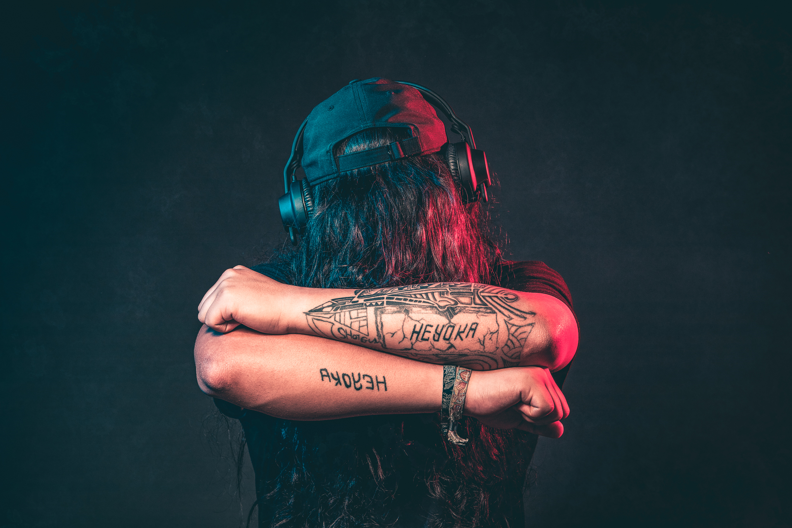
Session 10
Popular Music in Postdemocracy: Citizenship and Democracy

Slide 2
synopsis
Neoliberalism has thoroughly undermined egalitarianism, which calls into question the legitimacy of globalization and global hegemonic capitalism. We are in an age of interregnum, the historical point of postdemocracy, which raises questions about the idea of active democratic citizenship, and how this activism is mobilized though and manifested in world popular music practices. This session focuses on the postdemocratic conditions of today’s neoliberal culture and asks important questions about the role of social democratic citizenship, conceptualized here through the role of popular music in democracy and citizenship. Real World, The Elders, and Witness charity are all examples of social democratic citizenship that show that a more optimistic, moral stance toward globalization is possible.

Slide 3
Postdemocracy
since 1990s, state policies have favored the interests of the wealthy and socially advantaged, who have benefited most from the unrestricted operation of the capitalist economy (Crouch 2004:vii)
Sociologist Colin Crouch (2004) describes the current period as “post-democracy”, a new historical point in the parabola of economic globalization, marked by the strengthening of the “global firm”.
Notes:
Economic globalization has shaped a popular culture that extols celebrity and success, and that promotes and celebrates values of the public self and possessive individualism. It has thoroughly undermined the egalitarianism that underpinned the welfare state, with painful consequences for socially vulnerable groups, including women, ethnic minorities, the young and old, the disabled, and so forth. Capitalism, instead of suffering retreat, is strong and global, while political advantage has shifted away from desires to reduce inequalities of wealth and power.
Given that the neoliberal project is truly hegemonic on a global scale, the legitimacy of globalization and global hegemonic capitalism has thus been called into question routinely.
Sociologist Colin Crouch (2004) describes the current period as “post-democracy”, a new historical point in the parabola of economic globalization, marked by the strengthening of the global firm—large corporations that have outgrown the governance capacity of individual nation states—with its political importance, and the decline of the working class, both numerically and increasingly disorganized and marginalized within that life, and the growth of a powerful political class of political advisers and business lobbyists. State provisions for ordinary people’s lives have become increasingly insignificant.
Many countries have undergone complete commercialization of public services, including education, health, and other parts of the welfare state. Satisfaction with the conditions of liberal democracy has produced complacency with the rise of post-democracy. Global capitalism thereby leads to apathy, lack of affect, and depoliticized attitudes among young people around the world, who are “quite simply, ‘cool’ about the state of the world and how broken it seemed” (Cazdyn and Szeman 2011:162).
So while there has been political contestation to globalization, including feminist, gay, and anti-racist campaigns, critical opposition to capitalism has been somewhat marginalized in neoliberal times. Thus, campaigning social movements of peace, equality, feminism, ecology, and so forth as sources of resistance to neoliberalism are crucial for a twenty-first century democracy.

Slide 4
The post-democratic age means the trivialization of democracy due to the political and governmental control of privileged elites characteristic of pre-democratic times, signalling a crisis of egalitarian causes and politics that has rendered them increasingly impotent.
The shift toward postdemocracy raises questions about the idea of citizenship and signals a paradox in western democracies, in which “democracy has moved into a parabola” (5).
Notes:
Democracy and citizenship within the age of postdemocracy is the concern of the final three sessions, illustrating how this activism is mobilized through and manifested in different world popular music practices. This session is particularly interested in Peter Gabriel’s active citizenship.

Slide 5
Citizenship
The quality and character of social, democratic citizenship was historically linked to the welfare state during the mid-twentieth century, the heyday of “unrestrained capitalism” (Crouch 2004:97). Social citizenship stood at the opposite end of market competition and profit, and the inequalities of the capitalist component of society.
The search must be for ways of retaining the dynamism and enterprise of capitalism while preventing firms and their executives from exercising power to a degree incompatible with democracy. (Crouch 2004:105)
Notes:
The quality and character of social, democratic citizenship was historically linked to the welfare state during the mid-twentieth century. Social citizenship stood at the opposite end of market competition and profit, and the inequalities of the capitalist component of society.
Today, in postdemocracy, social citizenship is seriously challenged as the maximization of markets, private ownership, and big business’ ability to interfere with government stand in stark conflict with other (social) human goals. Since the arrival of neoliberal hegemony, the democratic rights of citizenship have been lost.
Yet a more optimistic stance is possible, which recognizes two concepts of the active democratic citizen today: positive citizenship, marked by collective identities and their expression of shared interests; and negative citizenship, marked by protectionist activism against others, especially the state.
While it is impossible to see any major reversal of capitalist practices in the music industry and, with it, the growing (political) power of the global firm, actions to try to shift away from the inexorable drift toward postdemocracy in all spheres of life are possible, including policies and actions available to concerned citizens themselves.

Slide 6
What can the active, positive citizen do to bring to terms global financial capitalism and its product of postdemocracy?
Robin James talks about “a social justice strategy” (2015:172).
Notes:
Critical disquisition to postdemocracy centers around the counterproject to the hierarchical world of cultural domination.
Active democratic citizenship seeks to address the “big issues” of politics and allows to hold more optimistic views in favor of what a globalized world can potentially offer. Active citizenship and, with it, alternative and oppositional thinking, seeks to overcome the impasse of neoliberal culture and policy. Active citizens critical of cool-capitalist culture engage with lifeworld issues often aesthetically and emotionally, which, in the realm of culture, is felt and expressed passionately and experienced as especially meaningful.
Robin James talks about “a social justice strategy” (2015:172) that requires most and foremost consciousness-raising and the recognition that the background conditions for multi-racial white supremacist patriarchy continue to support the vitality of only certain kinds of life.

Slide 7
Musical activism
Paul McCartney and Brian May have fought animal rights
Bono and his (American Express) consumer/corporate-invested RED Campaign
The charity single “Do They Know It’s Christmas” (1984) and subsequent Live Aid Concert at Wembley Stadium in 1985, organized by Bob Geldof and Midge Ure, raised awareness about and funds for the famine in Ethiopia
Posthumous celebrity activism in tribute of Freddie Mercury by fellow band members, including The Freddie Mercury Tribute Concert for AIDS Awareness in 1992 with support from the likes of David Bowie, Liza Minnelli, Annie Lennox, George Michael, Elton John and others, the resultant EP “Five Live” (1993) and DVD of the Tribute Concert (2002), and the 1996 exhibition of photographs of Mercury in the Royal Albert Hall in London, Japan, and other European cities, all in support of the charitable work of the Mercury Phoenix Trust, has provided significant funds to NGOs worldwide to help try and eradicate HIV/AIDS
Taylor Swift has been actively engaged in extensive philanthropy, charity, and “meet-and-greets” with fans with disability
Notes:
Popular musicians and artists have long recognized that music can function as a catalyst for social change, a means for political communication, and expression of democratic citizenship. For instance
rock artists like Paul McCartney and Brian May have fought animal rights by condemning proposals to bring back fox hunting in the UK (Lester 2015)
Bono and his (American Express) consumer/corporate-invested RED Campaign has provided funds to combat AIDS in Africa
the charity single “Do They Know It’s Christmas” (1984) and subsequent Live Aid Concert at Wembley Stadium in 1985, organized by Bob Geldof and Midge Ure, raised awareness about and funds for the famine in Ethiopia
posthumous celebrity activism in tribute of Freddie Mercury by fellow band members, including The Freddie Mercury Tribute Concert for AIDS Awareness in 1992 with support from the likes of David Bowie, Liza Minnelli, Annie Lennox, George Michael, Elton John and others, the resultant EP “Five Live” (1993) and DVD of the Tribute Concert (2002), and the 1996 exhibition of photographs of Mercury in the Royal Albert Hall in London, Japan, and other European cities, all in support of the charitable work of the Mercury Phoenix Trust, has provided significant funds to NGOs worldwide to help try and eradicate HIV/AIDS (Bennett 2017)
Taylor Swift has been actively engaged in extensive philanthropy, charity, and “meet-and-greets” with fans with disability.
Yet note, celebrity morality and humanitarianism has become central in celebrity brand management in the twenty-first century, raising, in some instances, questions about the hypocrisy of “selling via activism” (Rocavert 2017:14).
Optional further reading:
Who really benefits from celebrity activism?. 2015. Available at https://www.theguardian.com/lifeandstyle/2015/jul/10/celebrity-activism-africa-live-aid, accessed 27 March 2018.

Slide 8
Political activism
Katy Perry’s support of Democratic presidential candidate Hillary Clinton (“Roar and Stronger”)
Fleetwood Mac’s backing of Bill Clinton (“Don’t Stop”)
will.i.am’s support of Barrack Obama (“Yes We Can”)
Kid Rock is notoriously known for his support of Republican candidates, including Mitt Romney (in 2012) and Donald Trump (in 2016), while he sells Trump merchandise on his website
grime MCs championed Labour leader Jeremy Corbyn in the lead-up the general (snap) election in Britain
Notes:
Some music celebrities have aligned themselves directly with politics and politicians:
Katy Perry’s support of Democratic presidential candidate Hillary Clinton (“Roar and Stronger”),
Fleetwood Mac’s backing of Bill Clinton (“Don’t Stop”),
will.i.am’s support of Barrack Obama (“Yes We Can”) (Jamieson 2016).
Kid Rock is notoriously known for his support of Republican candidates, including Mitt Romney (in 2012) and Donald Trump (in 2016), while he sells Trump merchandise on his website. Kid Rock’s political views tend toward the libertarian and are strongly anti-left, and in a 2015 interview with Rolling Stone he referred to Obama as “Obummer” (Guardian Music 2017)
in June 2017 grime MCs championed Labour leader Jeremy Corbyn in the lead-up the general (snap) election in Britain through a live music event in north London that was organized by Grime4Corbyn, a grassroots campaign group to encourage electoral registration among BME youth (Duggins 2017a). The campaign group created a pro-voting registration website, featuring the track Corbyn Riddim, which sets a Corbyn speech to a bombastic instrumental (Duggins 2017b).

Slide 9
Active citizenship means to mobilize new social identities by recognizing…
their outsider status in the political system, and to make both noisy and articulate demands for admission…. We have already seen how feminist movements have provided very recent, very major instances of this. Ecological movements provide others. This constant scope for new disruptive creativity within the demos gives egalitarian democrats their main hope for the future. (Crouch 2004:116).
Notes:
Many popular musicians believe in the “democratic” nature of music and their musical and extra-musical practices in their fight for particular kinds of freedom and equality. Their musical practices embody democratic processes. Music is particularly a metaphor and model for democracy in the work of activist musicians (Love 2006). Activist musicians often address fundamental problems of social justice and difference in neoliberal democracies, which have historically assimilated difference.
Democratic practices do not change power relations in society. However, active citizenship means to mobilize new social identities by recognizing
their outsider status in the political system, and to make both noisy and articulate demands for admission…. We have already seen how feminist movements have provided very recent, very major instances of this. Ecological movements provide others. This constant scope for new disruptive creativity within the demos gives egalitarian democrats their main hope for the future. (Crouch 2004:116).

Slide 10
Many popular musicians around the world have related their practice to the values of democracy. They believe in the democratic nature of music and their musical practices in their fight for particular kinds of freedom and equality, evident in the work of activist musicians involved in various movements. In their music, they address fundamental problems of social justice and difference in neoliberal democracies, which have historically assimilated difference and are deeply embedded in the dualistic thinking in western culture through which the other is colonized by a variety of processes. Popular music thereby engages deep, fluid energies of civil society by modeling a concrete democratic conversation that embraces humanity, justice, and equality.

Slide 11
World Music
Democratic concerns, coupled with resistance to globalization, can be seen in the workings of the independent music record labels
World Music… yet criticisms surrounding musical appropriation!
[M]ore recent, mass-mediated kinds of cosmopolitanism… involved musical encounters orchestrated by prominent rock and pop stars in the west: Peter Gabriel, Brian Eno, Robert Fripp, Transglobal Underground, Sting, Natacha Atlas and others…. Though billed as exchanges and fusions, they graft exotic sounds onto a western rock and pop musical infrastructure and as such constitute – in my mind – a musical prolongation of nineteenth century orientalism…. [T]he cultural politics of these musical “exchanges” rarely attract comment, let alone criticism. And Gabriel, Eno, Fripp et al are serious musicians, after all. Most of us are inclined to give them the benefit of the doubt, I guess. We might consider this particular kind of cosmopolitanism, then, as appropriation by musical neo-orientalists for a western market in exotica. (Stokes 2007:8).
Notes:
Democratic concerns, coupled with resistance to globalization, can be seen in the workings of the independent music record labels, which are less tied to the corporate structures, and so also release music records from more varied musical styles and or grassroots music. The independents are also more willing to take risks, musically, politically, and financially, that the major labels are not willing to take.
As a product of economic globalization, World Music is inextricably tied up within these debates. Yet World Music has, at times, ignited pessimism about the historical, political, and economic subjugation and exploitation of the third world by powerful capitalist corporations, with dreary accusations of “appropriation” and as benefitting from western positionality.
Musical collaboration has often been scorned as musical appropriations. To ethnomusicologist Martin Stokes, pop star collaborations constitute nothing more than neo-orientalist forms of musical appropriation:
[M]ore recent, mass-mediated kinds of cosmopolitanism… involved musical encounters orchestrated by prominent rock and pop stars in the west: Peter Gabriel, Brian Eno, Robert Fripp, Transglobal Underground, Sting, Natacha Atlas and others…. Though billed as exchanges and fusions, they graft exotic sounds onto a western rock and pop musical infrastructure and as such constitute – in my mind – a musical prolongation of nineteenth century orientalism…. [T]he cultural politics of these musical “exchanges” rarely attract comment, let alone criticism. And Gabriel, Eno, Fripp et al are serious musicians, after all. Most of us are inclined to give them the benefit of the doubt, I guess. We might consider this particular kind of cosmopolitanism, then, as appropriation by musical neo-orientalists for a western market in exotica. (Stokes 2007:8).

Slide 12
World Music is not simply exploitative musical appropriation, but the result of the musical creativity and citizenship of the musicians…
“Nowhere in any of this was there the faintest whiff of exploitation, exclusivity, cliques, ghettoization, conspiracies, cultural imperialism, racism or any of the other nonsensical -isms that have been chucked at the notion since, often by people who ought to know better and in the end do little more than expose their own foibles. It was simply a great idea, followed up by a lot of unprecedented co-operation between enthusiasts (very few thought of each other as business rivals) who wanted others to have more opportunity to share their enthusiasms. Yes, it was good for business, but by being so it was automatically good for the incomes of the artists too. Of course … one can see that having such a simple concept without any baggage was still likely to bring problems. Even if the original idea was virus-free, it was bound to get thoroughly bugged as others logged on.” (Anderson 2000)
Notes:
The validity of the binary opposition between authenticity and commercialization is difficult to sustain. It would be misleading to view some music as a raw material that is simply mined by corporate interests. Indeed, ownership of musical styles is difficult to apportion.
Much popular music around the globe is the result of the musical creativity of the musicians, so “any ideas that these are innocent noble savages who are gonna be corrupted by Western influences is rubbish!” (Andy Kershaw, in Cooper, Hobson and Hobson 2013). Ian Anderson put it as follows: [quote]
How and why do such criticisms proffer that “for Gabriel, Africa is an antidote to the modern West, with its categorical and rigid distinctions between spirituality and sensuality, the body and technology, nature and culture” (Stokes 2012:113). Is that really how Peter Gabriel regards Africa?

Slide 13
The world music industry has had its fair share of criticism from academics. But I baulked at the idea that “all these producers” (though unnamed) behaved and thought uniformly. I felt uncomfortable about the underlying pejorative tone of these assumptions. Did they all act like “old colonial traders”? Did they feign a “vague sympathy for the Cuban regime” in order to do business on the island? Did they really all cultivate an “image of cosmopolitanism”? Who is actually being described here? As someone who was involved in the presentation of Cuban music in the UK during the 1980s, following closely the developments of Buena Vista Social Club and other albums produced by Nick Gold, and also as someone who wears three hats—that of academic, journalist and music producer—I do not recognize either myself or my colleague Nick Gold in these descriptions…. Why were our views not elicited? I am reminded of a Malian proverb, often quoted by Mali’s iconic desert musician, Ali Farka Touré: “If you shave the head of a man, he must be present”. (Durán 2014:2014)
Notes:
Lucy Durán, in her recent article titled “Our Stories, From Us, The ‘They’” (2014), put it as follows:
The world music industry has had its fair share of criticism from academics. But I baulked at the idea that “all these producers” (though unnamed) behaved and thought uniformly. I felt uncomfortable about the underlying pejorative tone of these assumptions. Did they all act like “old colonial traders”? Did they feign a “vague sympathy for the Cuban regime” in order to do business on the island? Did they really all cultivate an “image of cosmopolitanism”? Who is actually being described here? As someone who was involved in the presentation of Cuban music in the UK during the 1980s, following closely the developments of Buena Vista Social Club and other albums produced by Nick Gold, and also as someone who wears three hats—that of academic, journalist and music producer—I do not recognize either myself or my colleague Nick Gold in these descriptions…. Why were our views not elicited? I am reminded of a Malian proverb, often quoted by Mali’s iconic desert musician, Ali Farka Touré: “If you shave the head of a man, he must be present”. (Durán 2014:2014)
Indeed, listening to many World Music artists’ voices reveals a desire toward active democratic citizenship through producing, recording, promoting, and so forth of world music. Disregarding artists’ and producers’ desires and motives for musical modernization and/or collaboration as mere “appropriations” should thus be viewed with extreme caution. Such thinking thwarts any attempt to bridge the gap between cultures constructed by over-zealous cultural relativism and post-colonialist liberalism. Musical hybridity and democracy are thereby regarded as opportunities and positive consequence of globalization.

Slide 14
“musical incorporation” (Kheshti 2015) in the context of a transformed, contemporary World Music industry
World Music ignites optimistic views about the exuberance of new world popular musics created and owned by musicians themselves, and about World Music consumption as a gesture of solidarity against the conglomerates
Notes:
A more fruitful way of looking at phenomena of musical collaboration and mixing is, what Roshanak Kheshti termed, “musical incorporation” (2015) in the context of a transformed, contemporary World Music industry.
Incorporation refers to the ways in which people absorb that which they want to make their own. It conveys that the hybrid musical forms come to the listeners through noble and respectable methods, as opposed to through theft, which is typically the way that appropriation is thought of. By incorporating different sounds, musicians incorporate the cultural, historical, racial make-up of these sounds into themselves. The musical endeavors of Peter Gabriel, Youssou N’Dour, and others may thereby be understood within this transformed sense of appropriation in World Music.
World Music thus also ignites optimistic views about the exuberance of new world popular musics created and owned by musicians themselves, and about World Music consumption as a gesture of solidarity against the conglomerates.

Slide 15
Ian Anderson further argues:
It’s not all positive, but World Music (or Musique du Monde in neighbourly Paris) is way ahead on points. It sells large quantities of records that you couldn’t find for love or money two decades ago. It has let many musicians in quite poor countries get new respect (and houses, cars and food for their families), and it turns out massive audiences for festivals and concerts. It has greatly helped international understanding and provoked cultural exchanges – people who’ve found themselves neighbours in the same box have listened to each other and ended up making amazing music together. Oh, and it has allowed a motley bunch of enthusiasts to not yet need to get proper jobs. I call it a Good Thing, and just feel a bit sorry for people with the thinking time on their hands to decide they hate World Music… Lighten up, guys, it’s only a box in a record shop. (Anderson 2000)

Slide 16
Independents such as Peter Gabriel’s Real World offer a positive balance by promoting world musicians and artists to the Western-buying populace in highly ethical ways with an emphasis on human rights, fair pay, and cross-pollination between different musical cultures (White 2012:200). Real World’s aim is to provide talented musicians from around the world the opportunity to gain reach beyond their own geographical boundaries, and so makes an important contribution toward cultural exchange, knowledge, and appreciation of other cultures and their musics:
Notes:
“Before Real World, only with great determination, or a lot of travelling, was it possible to access music by artists working outside western Europe and North America. Now, you can stroll into high street stores and find CDs of music from every continent, many of them bearing the Real World colour bar logo. There is an enormous variety of styles, moods and genres on CDs that bear this logo.” (Real World 2015)
Image credit: Homepage screenshot, Real World Records. Available at https://realworldrecords.com/, accessed 27 March 2018.

Slide 17
Globalization has fuelled the education of consumers about different cultures, traditions, histories, and creativities around the world. It has created access to the rest of the world through travel, migration, and tourism.
In terms of music, globalization has brought not only musics from other cultures to the western sphere, but it has also initiated a desire in many artists to work collaboratively with foreign musicians, wherever “foreign” may be for them.
Notes:
Due to globalization, World Music has gained many followers in the western world over the last three to four decades, seeing the rising popularity of world music stars such as Buena Vista Social Club, Youssou N’Dour, and Mariza.
Thus even if the World Music industry may be regarded as a “cottage industry” within the music business with generally low record sales, World Music continues to contribute to the diversity of live and recorded music by new, non-mainstream artists.

Slide 18
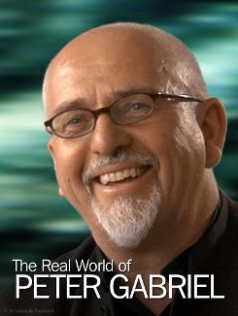
Notes:
One of the greatest proponents of promoting democracy in World Music is Peter Gabriel. Throughout a long career of writing, performing, and producing, musical collaboration and musical heterogeneity were some of his most enduring themes.
Gabriel was one of the principal organizers of the WOMAD foundation (World of Music, Art and Dance) and associated festival events (the first festival was held in 1982), the goal of which was the bringing together of musicians from all over the globe.
In the early 1980s, Gabriel created Real World Records; one of the first records released on this label was with the great qawwali singer Nusrath Fateh Ali Khan. In its thirty something years existence, the label has produced around 160 titles, many of which are the result of collaborations or fusions between musicians from different parts of the world or producers and artists from different backgrounds (Amanda Jones, interviewed in Maas and Zeppenfeld 2009). The idea behind Real World Records is collaboration on the basis that “when people are concerned with purism, they are denying the ability of a traditional artist to grow as an artist” (Michael Brook, interviewed in Maas and Zeppenfeld 2009).
Image credit:
Peter Gabriel profile, BBC online, 2018. Available at https://www.bbc.co.uk/music/artists/8e66ea2b-b57b-47d9-8df0-df4630aeb8e5, accessed 27 March 2018.
The Real World of Peter Gabriel. Available at https://www.proximustv.be/fr/film/853834291/the-real-world-of-peter-Gabriel, accessed 27 March 2018.

Slide 19
Notes:
Audio-visual study: The Real World of Peter Gabriel (2008)
The film was inspired by the 20th Anniversary of Real World Records and the release of last years long gestating collaborative album ‘Big Blue Ball’. This record was a result of some of the legendary ‘Real World Recording Weeks’ which took place in the 1990’s, where musicians from all over the world would get together and make music. The film gives an insight on the extraordinary atmosphere in which these sessions were held and also on the philosophy of Real World on the process of recording with producers and artists that come from different cultural backgrounds. Peter Gabriel himself got personal insights on the social and political conditions and problems in many countries by working with musicians from all around the world. In consequence he initiated political initiatives for Human Rights, like ‘Witness’ and ‘The Elders’. The filmmakers spent time at Real World going through the archives, filming interviews with key staff, including Peter Gabriel himself and also watching a recording session as it took place – ‘Syriana’ – a forthcoming project on Real World Records. Available at https://www.youtube.com/watch?v=UgTY5zGxh5A.

Slide 20
Big Blue Ball is I think an act of globalization. It’s an act of trying to bring the world together and to explore it. Globalization I think has had a bad publicity. As I think of myself as a global citizen, you know, I still have attachments to my country but I live and work with people from all around the world, and my life is so much richer. I’ve learnt so much more from having done that. (Peter Gabriel, interviewed in Maas and Zeppenfeld 2009)
Notes:
In 2008, the Big Blue Ball album was released, which is the product of many years of collaboration between artists and producers from different parts of the world. The album grew out of so-called recording weeks in 1991, 1992, and 1995 when Gabriel invited musicians playing at the WOMAD festival to meet, jam, swap musical ideas, play, and consolidate musical material.
The resultant Big Blue Ball album represents one of the greatest examples of musical hybridization and cultural cross-fertilization to date. Its release was accompanied by a visual art exhibition around its theme, at the center of which was a three-dimensional ball mapped out by white boards featuring video messages from places around the world, which sought to transform the large flatscreens into futuristic paintings. To Peter Gabriel, [quote]
Image credit: Cover, Big Blue Ball. Reproduced in the book with permission (see credits page 239), and reused here for educational use.

Slide 21
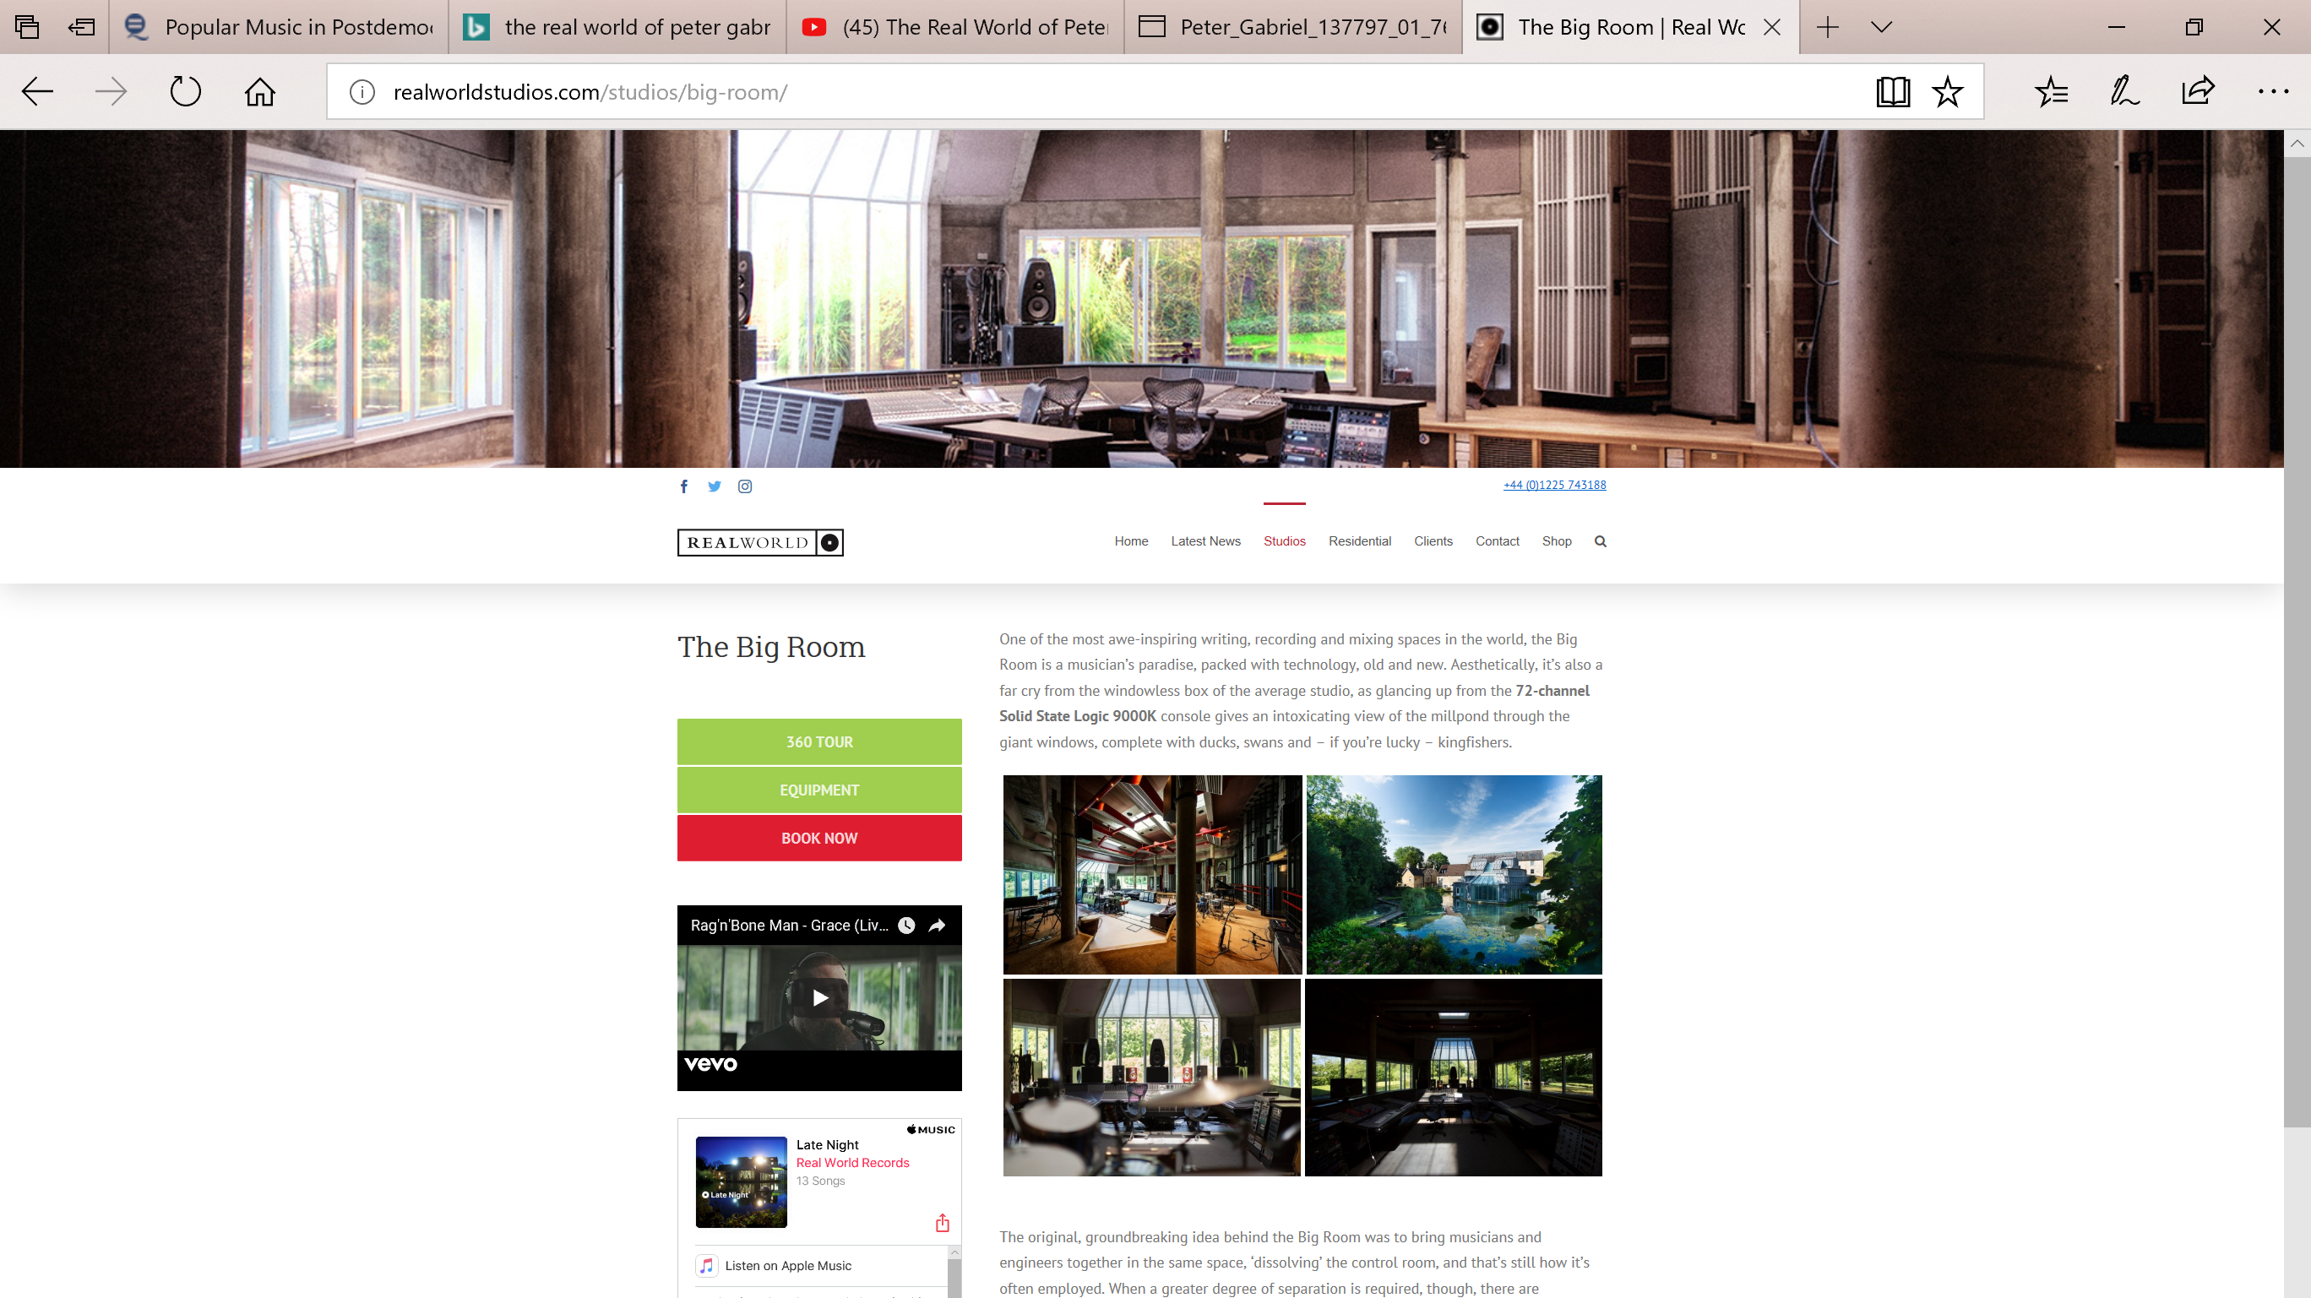
You can tell how civilized a person is by where they put the boundary between them and us and, the idea being, the more people you could include in the us-bracket, the better things will likely to be…. It’s very easy for us to think of others as them, and as soon as you start that division you have enshrined a problem. (Peter Gabriel, interviewed in Maas and Zeppenfeld 2009).
Notes:
Gabriel’s recording approach is shared across many of his albums, for instance the exact same “status” is afforded to Gabriel’s session guitarist, the English-born David Rhodes in terms of the recording mix. His Real World Recording Studio in Bath, which he founded around 1986, also evoke democracy.
The Studio was built around performance to make people feel comfortable, so there is no artificial separation between recording space and control room to break down the division between them and us. Gabriel continues to explain that
you can tell how civilized a person is by where they put the boundary between them and us and, the idea being, the more people you could include in the us-bracket, the better things will likely to be…. It’s very easy for us to think of others as them, and as soon as you start that division you have enshrined a problem. (Peter Gabriel, interviewed in Maas and Zeppenfeld 2009).
Peter Gabriel’s Real World company promotes artists from different cultures to the Western buying populace ethically, with an emphasis on human rights, fair pay, and an encouragement of cross-pollination between different musical cultures (White 2012:200).
Image credit: The Big Room, Real World Records. Available at http://realworldstudios.com/studios/big-room/, accessed 27 March 2018.
The website states:
One of the most awe-inspiring writing, recording and mixing spaces in the world, the Big Room is a musician’s paradise, packed with technology, old and new. Aesthetically, it’s also a far cry from the windowless box of the average studio, as glancing up from the 72-channel Solid State Logic 9000K console gives an intoxicating view of the millpond through the giant windows, complete with ducks, swans and – if you’re lucky – kingfishers. The original, groundbreaking idea behind the Big Room was to bring musicians and engineers together in the same space, ‘dissolving’ the control room, and that’s still how it’s often employed. When a greater degree of separation is required, though, there are 13 acoustic screens and two isolation booths available, as well as the option of joint-booking the Wood Room, for a more conventional divided control/live room setup.

Slide 22
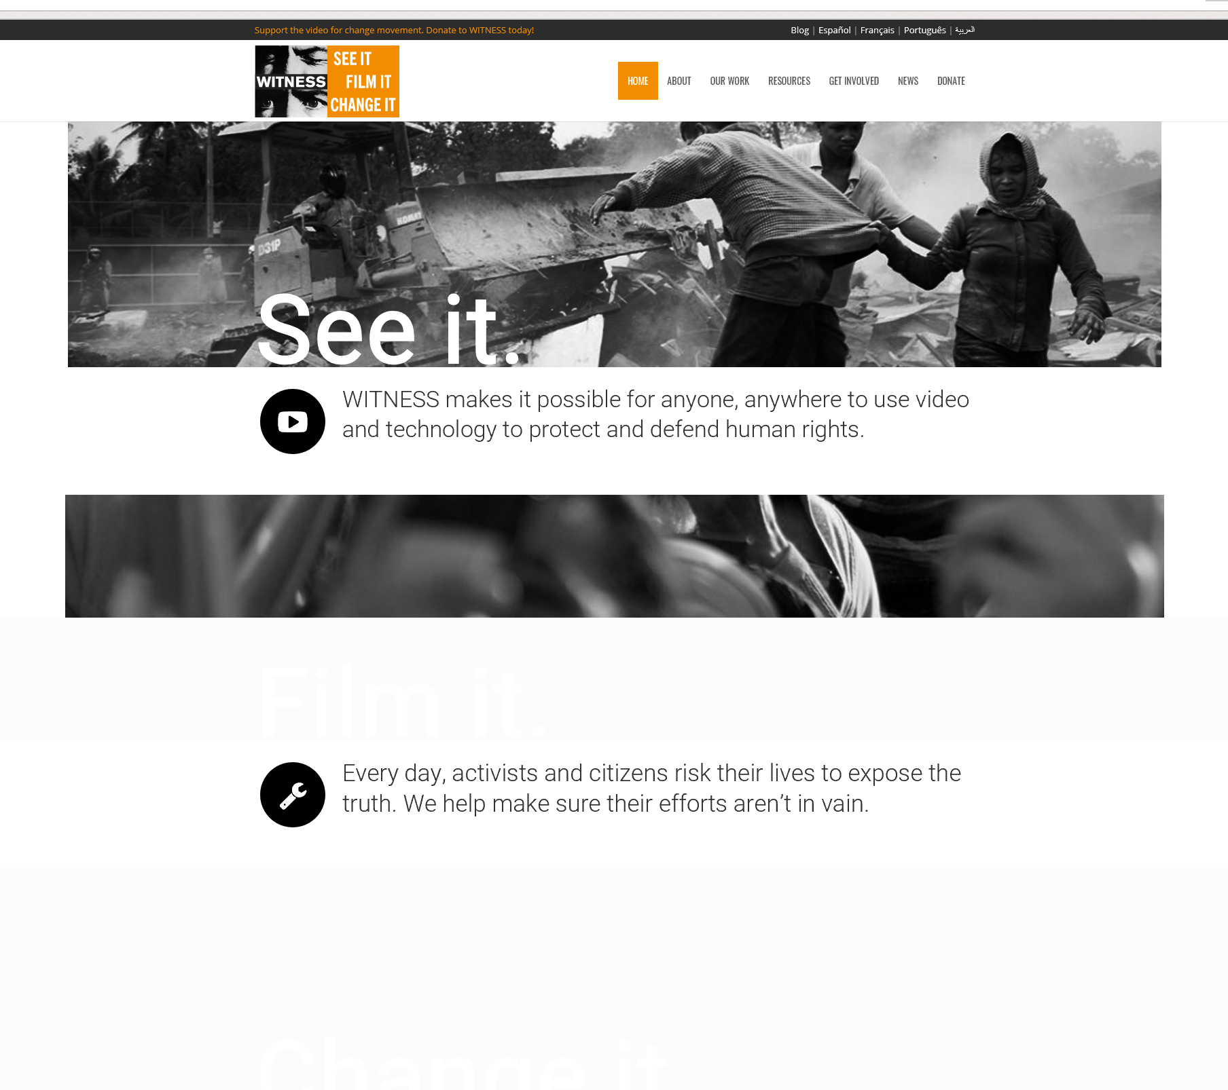
Globalization in fact supports Peter Gabriel’s, and many of the musicians he has collaborated with, human rights activism by embracing globalizing technologies (see Witness Org 2014), which in turn resembles a means of resistance to the negative globalizing tendencies.
Notable also is his work with Youssou N’Dour in raising awareness of Aids in Africa, or his efforts preserving music and arts in Cambodia.
Notes:
Image credit: Homepage screenshot, Witness organisation. Available at https://witness.org/, accessed 27 March 2018.

Slide 23
I think we are at a unique point in our evolution because for the very first time, anyone on the planet can communicate with anyone else on the planet in the same way I can go into Google Earth and actually go down to the tree in my garden. I should be able to… drill down and zoom in to the person who has lost their house in the cyclon, who has got HIV, who is in a warzone and hear their experience, their story, not in the words of the news channel, but in their words, so they can speak for themselves and be seen and heard. So I would call that a fundamental human right. And something we can now do with this technology, layer one, we have thought of Witness.org. Witness.org is a human rights organization we started about 16 years ago to try and encourage the use of technology in human rights campaigning. And the dream is that anyone that has bad stuff happening to them might be able to upload video images or photos or text of what’s going on, of their story and their experience. The power of observation, which was used to control people in old-world speak... is now being reversed on its head and is allowing ordinary people to control those in power. Layer two is connectivity and campaigning. Having told these stories, you know the people who care about them or might care about them and the people who are campaigning about them, how do you connect them around the world in such a way to make a difference. (Peter Gabriel, interviewed in Maas and Zeppenfeld 2009)
Notes:
Peter Gabriel talking about Witness.

Slide 24
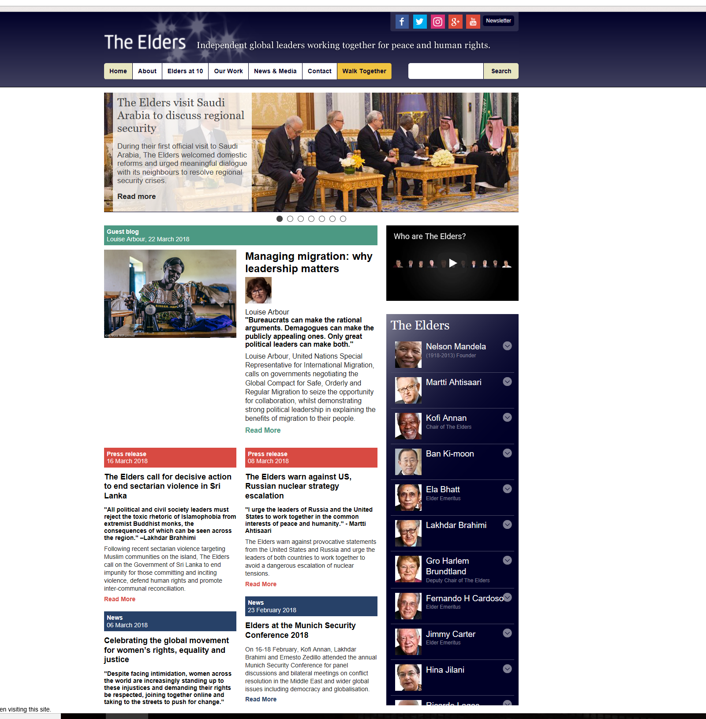
Notes:
In embracing globalization, Peter Gabriel is also critically aware of the absence of global governance for a global civil society and thus conceived (together with Richard Branson) the idea of The Elders. They proposed their idea to Nelson Mandela, who brought together The Elders in 2007 to form “an independent group of global leaders who work together for peace and human rights” (The Elders 2014).
Image credit: Screenshot of homepage, The Elders. Available at https://www.theelders.org/, accessed 27 March 2018.
Audio-visual study [embedded YouTube video]: Richard Branson and Peter Gabriel share their thoughts on the founding of The Elders. 2008. Available at https://www.theelders.org/article/richard-branson-and-peter-gabriel-share-their-thoughts-founding-elders, accessed 27 March 2018.
Further website information (see https://www.theelders.org/about):
The Elders are an independent group of global leaders working together for peace and human rights.
The Elders represent an independent voice, not bound by the interests of any nation, government or institution.
We are committed to promoting the shared interests of humanity, and the universal human rights we all share.
We believe that in any conflict, it is important to listen to everyone - no matter how unpalatable or unpopular this may be.
We aim to act boldly, speaking difficult truths and tackling taboos.
We don’t claim to have all the answers, and stress that every individual can make a difference and create positive change in their society.

Slide 25
The potential of globalization, offered to us by the benefits of mass communication and technologies, cultural cross-fertilization, and multiculturalism, is very high and one of great humanitarian value. It indeed provides opportunities for greater cross-cultural understanding and appreciation. Many similar contemporary musical practices may be understood within the context of a diasporic cosmopolitanism underpinned by neo-Kantian cosmopolitan values, in which there is a genuine acceptance of the cultural other and the possibility of a togetherness in difference.

