Slide 1
Session 3
The Other in Popular Music

Slide 2
Synopsis
In considering the economic and technological dimensions of globalization and their impact upon society and culture, this session is concerned with the politics of othering in popular music under liberal and organized capitalism, as these have been born out of historical, economic, social, and cultural manifestations of modern globalization. We will discuss the politics of othering through racialized and gendered representations in popular music since its beginnings in the late nineteenth century.
Notes:
Modern globalization, that is, expanding global capitalism, also has an “ugly” side to it, conceptualized through the politics of othering in popular music. Representations in much world popular music function in the construction of difference and otherness through racialized and gendered discourses within the hegemonic order of the global music business and wider society.
Therefore, notions of identity, power, and inequality are critical in discussions on the globalization of popular music. The institutionalization of sexist, racist, and other othering sentiments, coupled with commercial opportunism, has shaped the
stereotypes and narratives around much commercialized popular culture. Such categorizations highlight difference, marked by the politics of othering.

Slide 3
Politics of racialization
Race is steeped in the engineered histories of modern Europe
white definitions of whiteness constructed in terms of their differences from non-whites
US-based “negro market” of “race records”, reflexive of deep-rooted racialized ideas and narratives…. also shaped contemporary popular culture
Notes:
A deeply connected theme here concerns the politics of racialization, which has persisted well into present-day popular culture. European expansionism and colonialism have shaped early globalizing trends and provided the conditions for western forms of racialization in much popular commodified culture.
Since the early beginnings of the US-based music industry, popular music entrepreneurs promoted a “negro market” of “race records”, which included genres like blues and jazz, and later soul.
The discussions that follow here offer explanations about the racialized narratives expressed through and experienced in expressions of racialization in popular culture and explore more outwardly racist expressions in fascist popular music.

Slide 4
RACE MUSIC, RACE RECORDS IN THE US
Late 19th century:
plantation-derived stereotypes of black entertainers
stereotyped characters of African-Americans, including the smiling “Sambo”, the Jim Crow, the Zip Coon, the black muck, Mammy, Uncle Tom, etc., and depicted “African-Americans as happy-go-lucky slaves fit only for the hard work and dependence of plantation life” (Dinerstein 2017:43).
Southern jazz venues of the 1920s with names like Cotton Club, Plantation Club, Kentucky Club, or Club Alabam, and jazz bands like McKinney’s Cotton Pickers, the Dixies Syncopators, or the Chocolate Dandies are remnants of the racist history of popular entertainment for whites within predictable plantation-derived tableaux
“most Americans believed in the reality of these racial types as co-invented by Northern minstrels and Southern slave owners to emphasize black inferiority, and perpetuated both by pseudo-scientific theories of social hierarchy and Hollywood imagery” (Dinerstein 2017:43-44).
jazz and blues recording developed into a separate music category
Notes:
Black music (except “refined” versions for white audiences) had not yet been included in the record companies’ catalogues due to a long history of racial segregation. The business of early American popular entertainment was Southern-based, which shaped the plantation-derived stereotypes of black entertainers. Southern jazz venues of the 1920s were remnants of the racist history of popular entertainment for whites. Racially-based musical censorship by radio stations and a general disinterest in black audiences meant that jazz and blues recording developed into a separate music category.

Slide 5
Early 20th century:
Music record production and broadcasting was outwardly racist
promoted a “negro market”
growing demand for classic blues recordings
“race market” for “race records”, 78 rpm phonograph records that were marketed predominantly to African Americans since the 1920s
Ownership of “race music” was firmly in the hands of white entrepreneurs and their record labels
Between 1945 and 1949, Billboard published a Race Records chart
Notes:
The remnants of racism were well alive in the US-based music recording industry in the early twentieth century:
Music record production and broadcasting was quite literally split into “white” and “black”.
The still legally segregated, established white venues and radio stations usually barred black artists from performing live.
“Race records” included genres like blues and jazz, and later soul. Only few African American artists were marketed to white audiences, however white Americans gradually began to like and purchase “race records”.

Slide 6
Assumption that specific musical tastes would be in some way be connected to audiences’ racial identities
… reinforced deep-rooted racial essentialism and transplanted it to modern sound recordings
1950s rock ‘n’ roll becomes America’s popular music
Even so, racial identity continued to shape the way that African American music was portrayed in American popular culture
Notes:
Early record labels marketed particular musical styles to distinct markets of African Americans, Italian Americans, Jewish Americans, and others. Until 1964, many American states still had racial segregation laws. During the 1940s, thousands of rhythm ‘n’ blues records aimed at black audiences were sold (with profits pocketed by the white company owners). By the 1950s, white rock ‘n’ roll evolved and became America’s popular music.

Slide 7
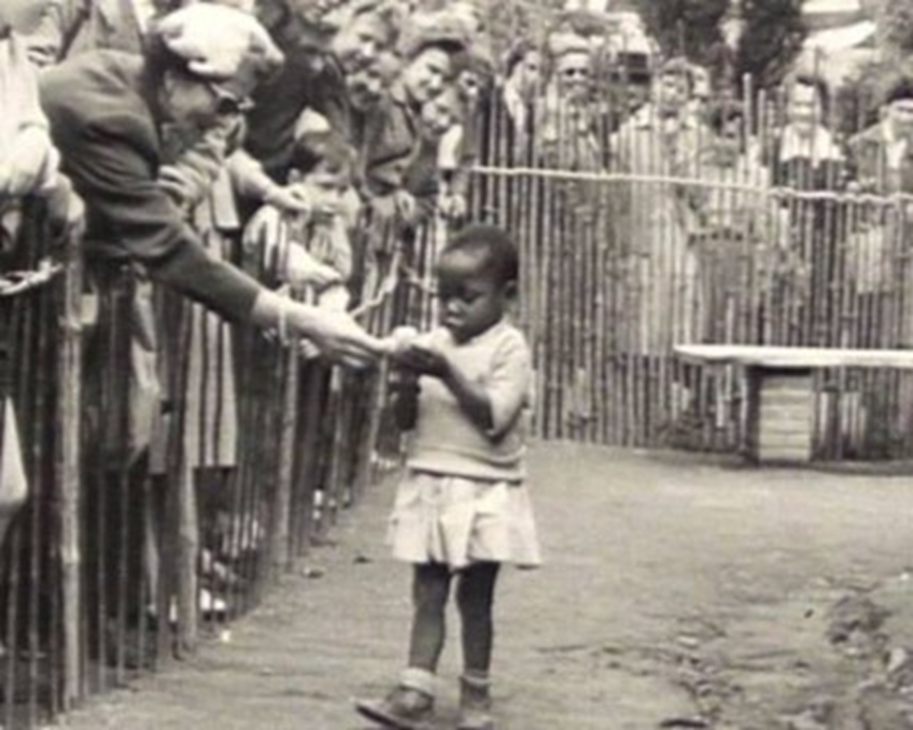
The Politics of Racialization
Notes:
The pervasive race consciousness in modern consumer cultures was partly shaped and informed by the conditions of modernity when social stratification based on race was blatantly visible and officially sanctioned.
One contentious case of social stratification was the exhibition of human beings in “human zoos” in European cities like Paris, Hamburg, Antwerp, Barcelona, London, Milan, Warsaw, Oslo, and New York. Throughout the late 19th century, and well into the 1950′s, Africans and in some cases Native Americans, were kept as exhibits in zoos. Far from a relic from an unenlightened past, remnants of such exhibits have continued in Europe into the mid-twentieth century. Throughout the early 20th century, Germany held what was termed a, “Peoples Show,” or Völkerschau. Africans were brought in as carnival or zoo exhibits for passers-by to gawk at. Only decades before, in the late 1800′s, Europe had been filled with, “human zoos,” in cities like Paris, Hamburg, Antwerp, Barcelona, London, Milan, and Warsaw. Between 1877 and 1912, approximately thirty ethnological exhibitions were presented at the Jardin zoologique d’acclimatation in Paris.
Above photograph is from Brussels, Belgium in 1958, depicting visitors feeding a girl with bananas. Image source: https://www.popularresistance.org/deep-racism-the-forgotten-history-of-human-zoos/, last accessed 5 October 2015.

Slide 8
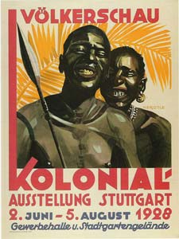
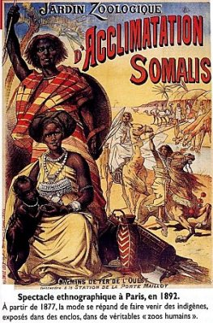
Notes:
Image source: https://www.popularresistance.org/deep-racism-the-forgotten-history-of-human-zoos/

Slide 9
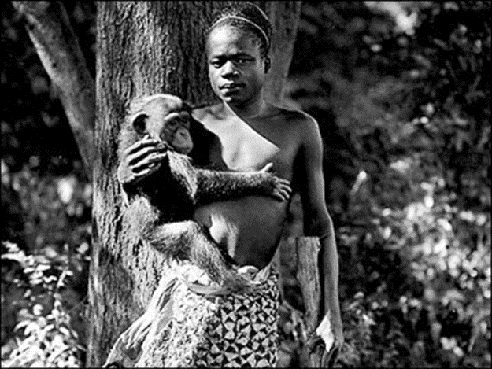
Notes:
New York too saw these popular exhibits continue into the 20th century. There was an average of 200,000 to 300,000 visitors who attended each exhibition in each city. In 1906, the amateur anthropologist Madison Grant, who was the head of the New York Zoological Society, put a Congolese pygmy Ota Benga, on display at the Bronx Zoo in New York City. The display was in the primate exhibit, and Ota was often made to carry around chimpanzees and other apes. Eugenicist and zoo director William Hornaday labeled Ota, “The Missing Link.”
Image source: https://www.popularresistance.org/deep-racism-the-forgotten-history-of-human-zoos/

Slide 10
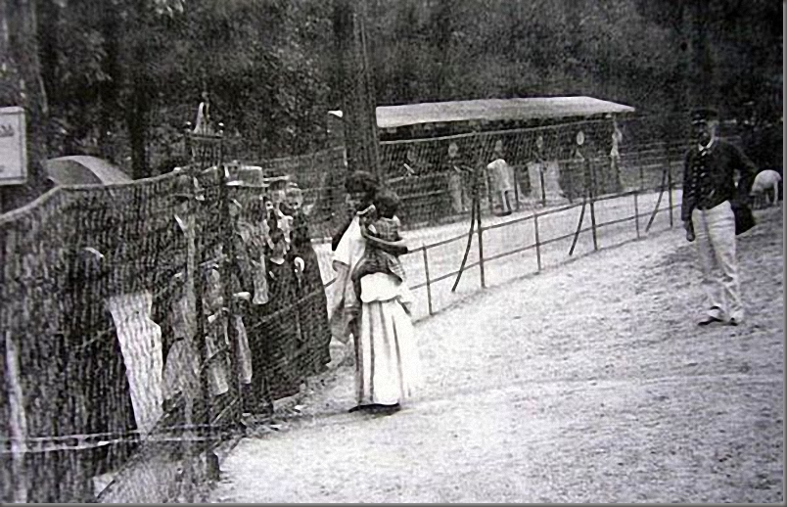
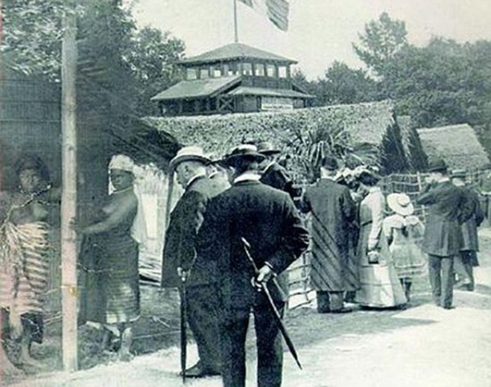
Notes:
The idea of “a Negro Village” was the most popular in Germany, where the ideas of Social Darwinism were widely spread and accepted by many people. Even Otto Bismarck visited “the Negro Village” exhibition.
Image source: https://www.popularresistance.org/deep-racism-the-forgotten-history-of-human-zoos/

Slide 11
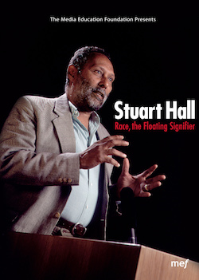
Notes:
European colonialism has led to social stratification and social injustices, such as discrimination, stereotyping and disadvantage. Social stratification refers to ‘the ordering of society into hierarchies of people in relation to the amount of broadly defined privileges they enjoy’ (Kotarba and Vannini 2009:93). Race, ethnicity, as well as gender, age, class, and so forth are important markers of social existence and identity. They are causes and/or effects of social and cultural forces; socially and/or discursively constructed by different groups of people. They are “real” in the sense that they are outcomes of processes of social interaction, such as what it means to be a man or woman, black or white, and so forth, while these meanings are always subject to interpretation and change.
Optional audio-visual study: The film The Mission depicts 18th century Spanish Jesuits trying to protect a remote South American Indian tribe in danger of falling under the rule of pro-slavery Portugal. [excerpt from Disc 2, chapter 3. 9:30mins] During early European expansionism, the Roman Catholic Church asked questions as to whether the “primitive” creatures” encountered by Europeans who arrived in the Americas and elsewhere were actually belonging to the same species, e.g. are they human? The church supported the construction of human subordination and domination in order to justify slavery and exploitation of the indigenous population by Spanish and Portuguese colonialists.
“Race” (la raza) was first used to define Christian aristocratic bloodlines during the Reconquista in the early modern Iberian Peninsula. It became transformed by modern European colonialism and the slave trade, during which “race” was used to justify slavery and colonial hierarchies. The European racially classifying system emerged when peoples from different cultures first encountered another, e.g. the Old World encountering the New World, and had to make sense of peoples who were significantly different from them (Hall 1997:11). The church supported the construction of human subordination and domination in order to justify slavery and exploitation of the indigenous population by Spanish and Portuguese colonialists in the New World. During the European Enlightenment, which celebrated human equality on the basis that everybody is one species, religious discourses were replaced by anthropological ones in order to “mark the difference inside the species [and] how, why one bit of the species is different – more barbarous, more backwards, more civilized – than another part” (Hall 1997:12). Anthropology now forged “The Truth” about human difference and social human classification, which was based in the biological discourses of Social Darwinism. (Darwin’s On the Origin of Species (1859) introduced the idea that race might be inscribed within an evolutionary framework. ). Most of the racial studies from anthropology have influenced scientific racialism. In more recent years, science has sought to utilize higher genetics in the laboratory in order to explain “why these people do not belong in the same camp, why they are very different from one another, why they really are a different species” (Hall 1997:12). Anthropology and science thus sought to define race on the basis of alleged biological and physical characteristics, such as skin pigmentation, hair, etc. (“color, bone, and hair”) in order to draw divisions between human groups and rank “racialised” groups hierarchically. In Britain, America, and Australia, the historical construction of race is therefore one of power and subordination where “colored” people have been disadvantaged in social, political, and cultural life, such as in the labour and housing market, the education system, as well as in media representations.

Slide 12
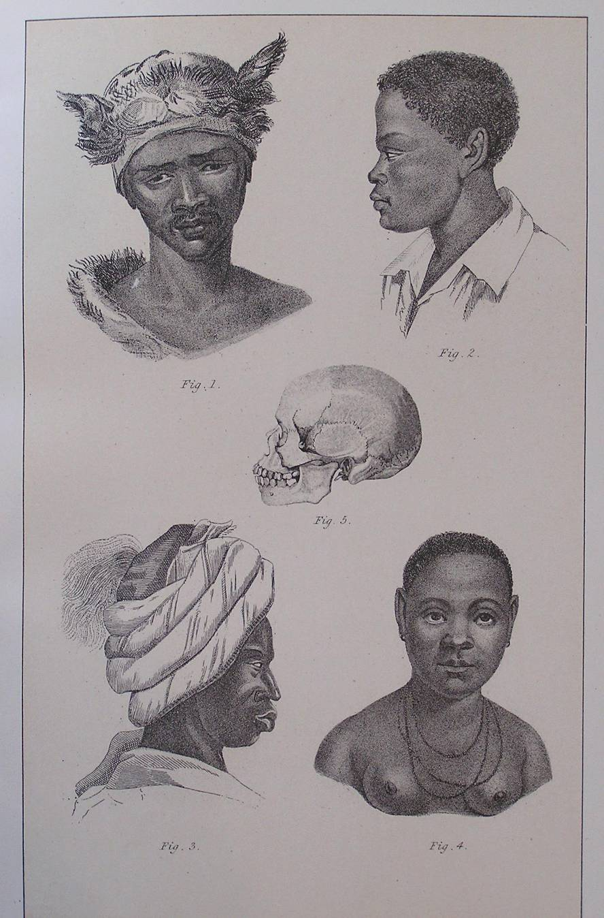
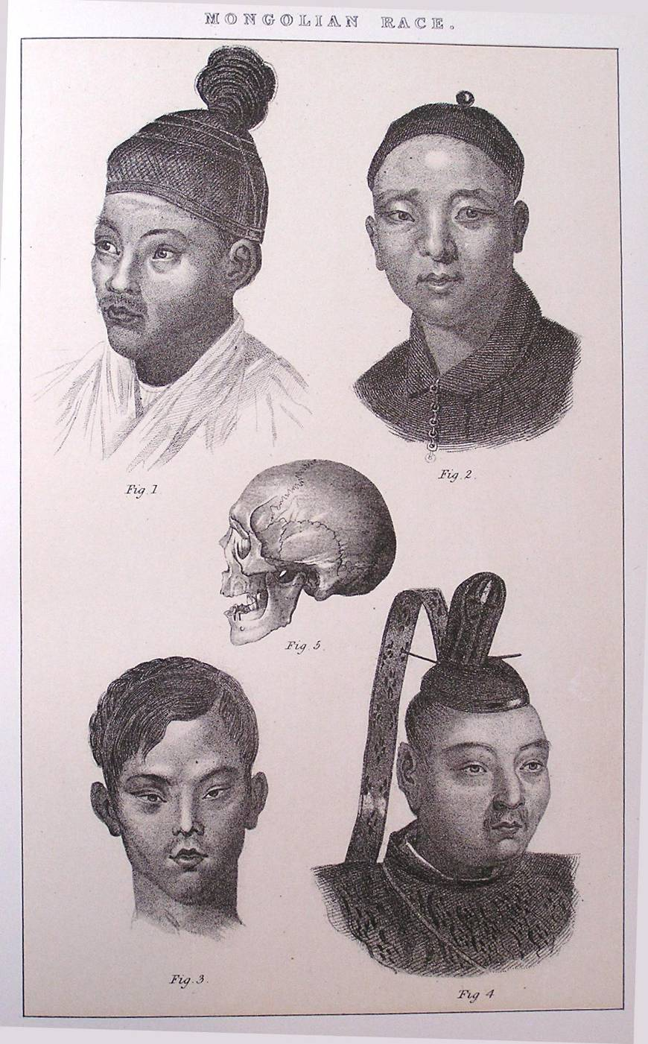
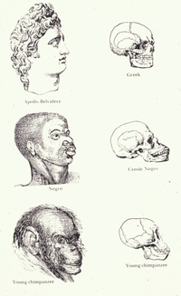
Notes:
Along social Darwinist lines, French naturalist and zoologist Baron Georges Cuvier’s Natural History (2012 [1890]) portrays the “Human Race” as divided into three categories (e.g. Caucasian, Mongol, and Negro), while Swedish biologist Linnaeus’s General System of Nature (1735) established four basic colour types in descending order (e.g. White Europeans, Red Americans, Yellow Asians, and Black Africans). The plates from Baron Cuvier's Natural History (1890) portray the “Human Race” as divided into 4 categories: American Indian, Caucasian, Mongol and Negro (the same as Linnaeus), and show the varieties within these colour coded groups. Each plate purports to show details of human types. The inclusion of the skull is representative of the materialist anthropology and physiognomy of the time.

Slide 13
Notes:
Race has a long history of shifting meanings; it is not a universal or absolute concept. According to Stuart Hall, race is “a discursive construct… a sliding signifier” (1997:5), which is discursively constructed. This is illustrated in the historical shift of the meaning of the word “race”.
Optional audio-visual study: Racism: A History (episode 1), which examines how ideas of racial difference have evolved in response to historical events.

Slide 14
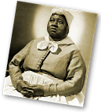
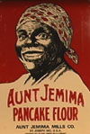
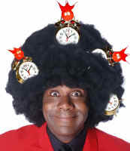
Media representations
Commodity racism
Clown figures
Rising Middle class non-threatening
slave figure
Notes:
The institutionalization of racist sentiments and implications has shaped the stereotypes and narratives around much commercialized popular culture.
Prior to the American Civil War, slaves were depicted as benign and happy with their position; during the Reconstruction when there was pressure on resources, this image was replaced by “the black brute” raping (white) women, a trend that continued in the early twentieth century.
The most racist stereotypes often echoed colonial and slave histories in both Britain and America evident in early Hollywood films .
Since the late 1950s and 60s, representations have often centered on the idea that there was something intrinsically criminal about black culture, leading increasingly toward imagery of black youth as muggers, urban rioters, and criminals. edia racism in the west became tainted by images of hedonism, evasion of work, and criminality.
By the late 1990s and early 2000, representations of potentially gun-toting members of drug-crazed gangs suggest that there is thus a clear continuity in the representation of this particular group as a criminal threat to the social order.

Slide 15
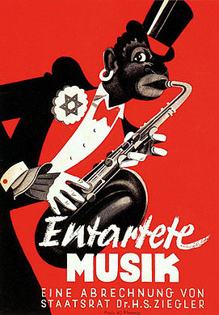
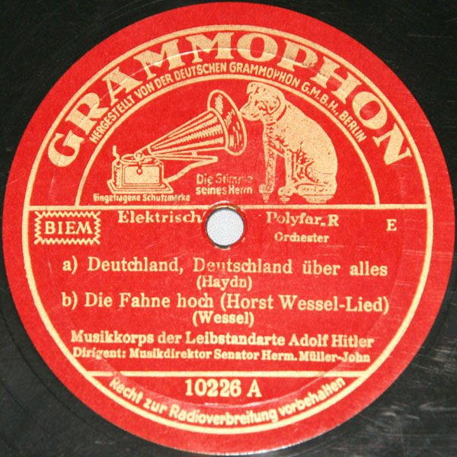
THE REMNANTS OF FASCISM IN ROCK MUSIC IN EUROPE
Notes:
During the 1930s, the Nazis were consolidating their power in Germany, and Fascism was advancing in Europe, an umbrella term for all extreme nationalistic and dictator-led anti-liberal, anti-Jewish and anti-Marxist movements that opposed parliamentary democracy. The ranks of entertainers were thinned out by the Nazis, and many artists fled to the US and Britain, while the Nazi-controlled record companies only released Aryan music (music by Blacks, Jews was banned/censored; see image titled “Entartete Musik [Degenerated Music]). The German record industry was forced since 1933 to adopt to the National Socialist ideology.
Fascist music (e.g. nostalgic and escapist songs, martial music) became a means to attempt to appeal to the masses and create groups of followers submissively dependent on their leaders. Typical was, and still today is, the transformation of existing musical material (workers songs, folk songs, military songs) with an already established mass appeal into aggressive right-wing combat songs by using new nationalistic lyrics and/or changes in the musical arrangements.
This approach is characteristic of all fascist movements.
Image (left) credit: Propaganda poster portraying jazz and especially saxophone music as 'entartete musik’; https://portal.picture-alliance.com/portal/resultview/searchresult/print/34987873, accessed 20 March 2018
Image (right) credit: Musikkorps Der Leibstandarte Adolf Hitler* ‎– Deutschland, Deutschland Über Alles / Die Fahne Hoch (Horst Wessel-Lied) / Badenweiler Marsch; https://www.discogs.com/Musikkorps-Der-Leibstandarte-Adolf-Hitler-Deutschland-Deutschland-%C3%9Cber-Alles-Die-Fahne-Hoch-Horst-W/release/3517989, accessed 20 March 2018

Slide 16
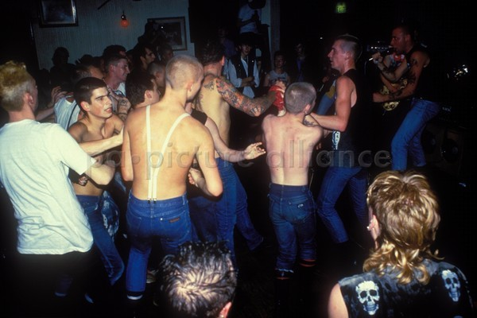
Notes:
After WWII, while explicitly neo-fascist parties became marginal in most European countries, for some young people Nazi symbols’ shock value still constitutes their key attraction.
In the late 1960s, some rock and punk music started to contain racist ideologies, antisemitism, abortion policies and gender issues, homophobia, anti-labor and anti-welfare politics, instigated by the British skinhead scene.
In the early 1970s, and with decreasing popularity of the skinhead movement, some skinheads joined neo-Nazi organizations like the National Front and the British Movement. The skinhead scene flourished again and with it the number of supporters of the National Front. This second skinhead generation listened to punk music, also known as Oi! Music, “white” music by bands like Sham 69. Oi! music is a description for fast punk rock. Oi! music expresses political opinions, while right Oi! music entices violence in nearly all songs.
Image credit: Skinheads moshing to a band, Brighton, UK 1983, by John G Byrne; https://portal.picture-alliance.com/portal/resultview/searchresult/print/55403962, accessed 20 March 2018.

Slide 17
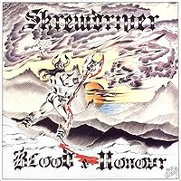
Neo-Nazi rock: Skrewdriver
Notes:
Examples of Neo-nNzi rock songs:
Tomorrow belongs to me (1984)
Bring Back the Glory of Deutschland
Blood and Honour (1985)
Pride of a Nation (1987)
Optional audio-visual study: Screwdriver documentary. Part I available at http://www.youtube.com/watch?v=VF4XdWp6-Ec; Part II available at http://www.youtube.com/watch?v=fDwX5jvsZ18&feature=related
Weblink reading: Whelan, Brian. 2013. Ian Stuart Donaldson and a legacy of hate. Available at https://www.channel4.com/news/ian-stuart-donaldson-a-legacy-of-hate, accessed 20 March 2018.

Slide 18
The racialized narratives expressed through and experienced in popular music during the 1960s and 1970s draw on the idea of race circulating in the European imaginary since European expansionism and colonialism, and hence the dawn of modern globalization. Nazi Rock is an example of this. Racialization is based on an ideology that has grown out of the desire of white Europeans to rule in order to achieve and maintain dominance.

Slide 19
Masculine Hegemony in the Music Industry
Notes:
In considering the politics of othering, a second theme concerns the sexist nature of the post-war music recording industry, which has spread gendered values, beliefs, and behaviors via representations in popular music on a global level.
Image credit: https://static.pexels.com/photos/230986/pexels-photo-230986.jpeg

Slide 20
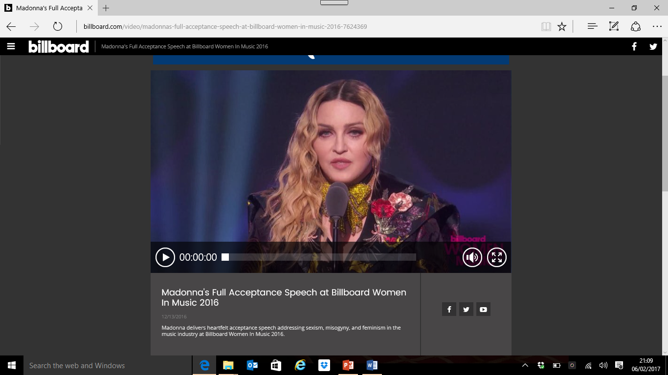
http://www.billboard.com/articles/events/women-in-music/7617021/madonna-billboard-women-in-music-2016-speech
Notes:
In her recent acceptance speech at Billboard Women in Music 2016, Madonna addressed in deeply emotional ways the sexism, misogyny, and feminism she has experienced during her career spanning three decades in the
music industry.
Weblink for optional audio-visual study: http://www.billboard.com/articles/events/women-in-music/7617021/madonna-billboard-women-in-music-2016-speech

Slide 21
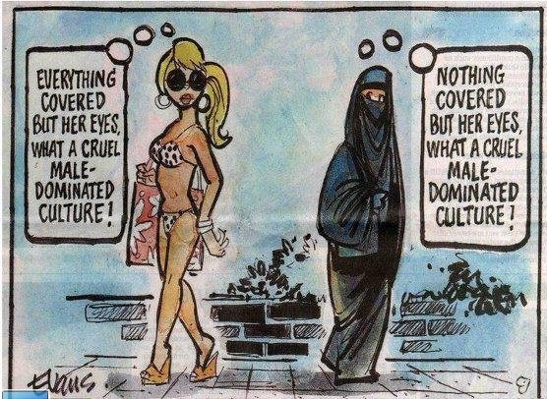
The naturalizing of gendered stereotypes in the global music industry has meant that women were, and still often are, the other in popular music.
Historically, popular music has been created, produced, and promoted from a fundamentally sexist, misogynistic, and ageist position, maintained through the construction of the popular music canon.
Notes:
Image credit: http://www.patheos.com/blogs/mmw/2012/01/how-are-muslim-women-doing-in-political-cartoons/, accessed 20 March 2018

Slide 22
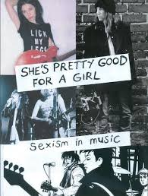
Sexism has permeated the whole structure of the music industry, including its business workings (and particularly senior executive positions), the creative processes surrounding songwriting and production, musical performance, and music journalism!
Notes:
Image credit: http://shesprettygoodforagirl.blogspot.co.uk/2012/09/sexism-in-music.html, accessed 20 March 2018

Slide 23
“Typical” female & male jobs in music
PR-related and secretarial roles
assistant positions
The myth of the “attractive secretary”
menial journalistic tasks
A&R and music journalism
biographers
have written, performed, and recorded music
critics and radio DJs

Slide 24
Sexualization in the 1950s and 60s
Rock music has been gendered masculine. It is essentially sexist by expressing masculine sexuality and superiority, as well as offering only limited representations of women, either as caring mother figures or as sex objects
Women musicians who “made it” were almost always singers, while women in the wider business usually worked in publicity. In both roles, however, women’s success depended on a male-made female image.

Slide 25
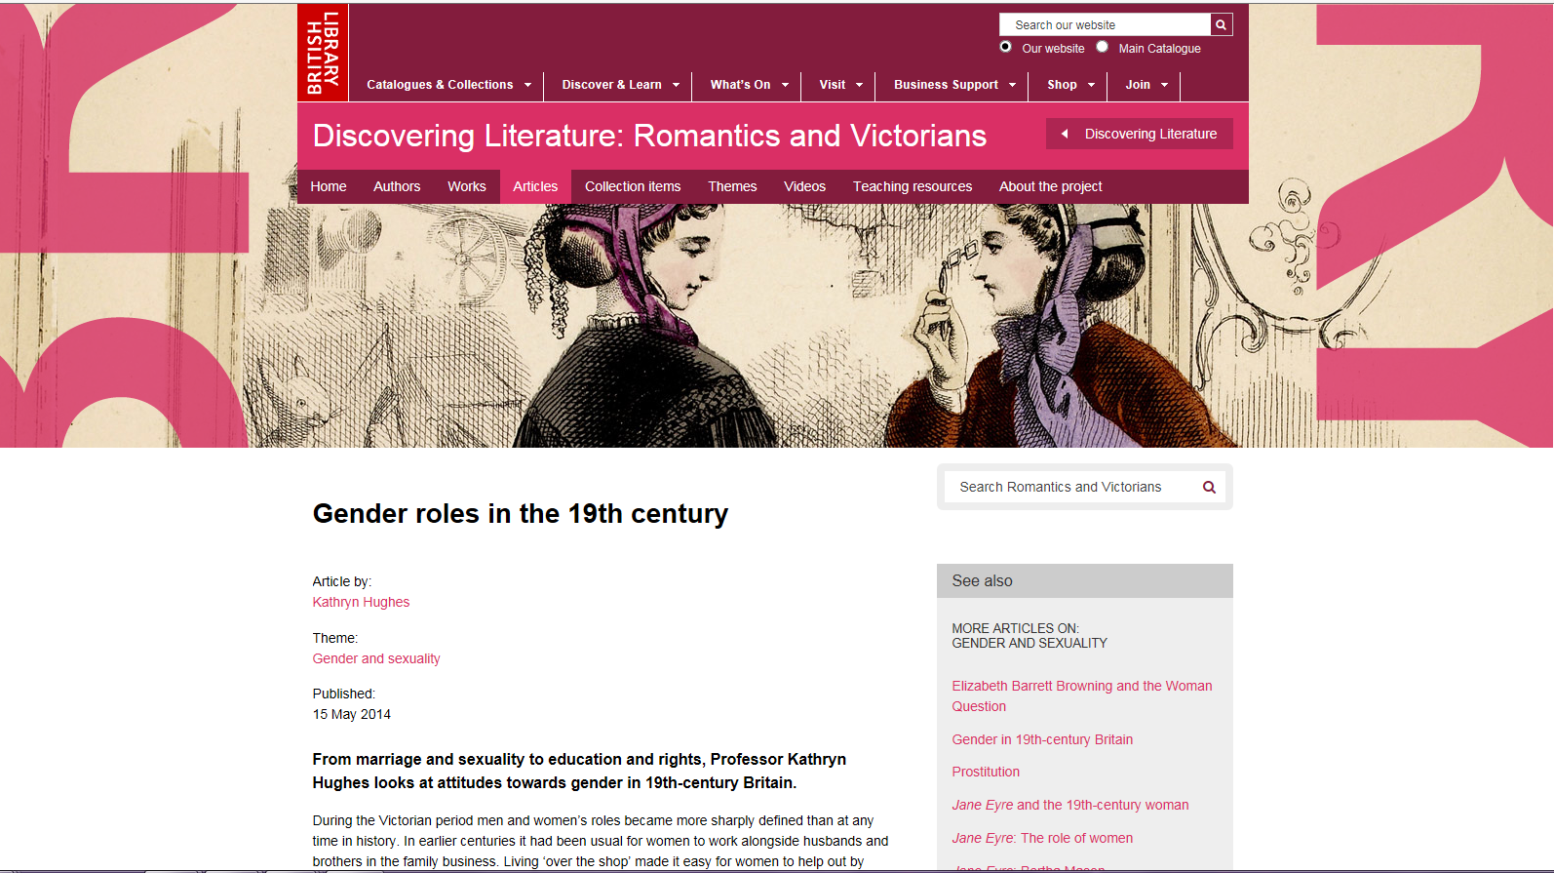
Historical context
The undervaluing of female authenticity and creativity is not limited to rock music, but has occurred in western societies since the romantic era when distinctions between low and high culture were first established.
Notes:
Weblink for optional further reading: Hughes, Kathryn. 2014. Gender roles in the 19th century. Available at https://www.bl.uk/romantics-and-victorians/articles/gender-roles-in-the-19th-century, accessed 20 March 2018

Slide 26
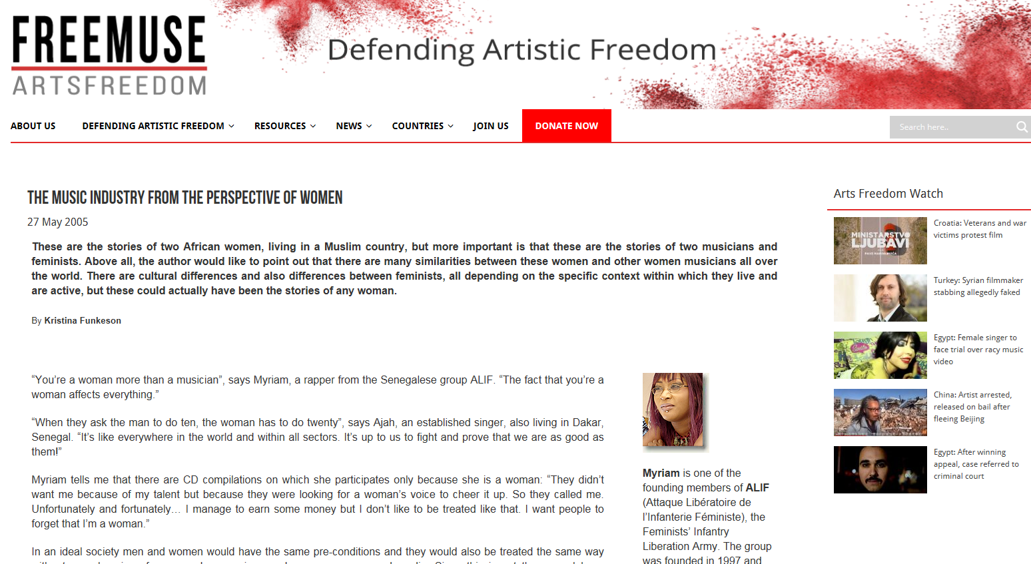
Worldwide phenomenon?
Sexism is not only confined to the Western music industry, but can also be found in other parts of the world
Notes:
Weblink for optional further reading: Kristina Funkeson. 2005. The music industry from the perspective of women. Available at https://freemuse.org/news/the-music-industry-from-the-perspective-of-women/, accessed 20 March 2018.

Slide 27
Sexualization in Rock Music
Rock is indeed the popular music genre that is most explicitly concerned with sexual representation
Since the 1950s and 60s, many rock musicians like Elvis Presley, Mick Jagger, Roger Daltrey, Robert Plant, and bands like Mötley Crue and Thin Lizzy became known under the substyle of cock rock
Masculinity is also enacted through the “exscription” of the feminine and misogyny
Notes:
Optional [embedded] audio-visual study: Classic Hard Rock News Special Report: Harmless Sex Or Sexism In Music. Available at https://www.youtube.com/watch?v=CyavbtCpk9c, accessed 20 March 2018

Slide 28
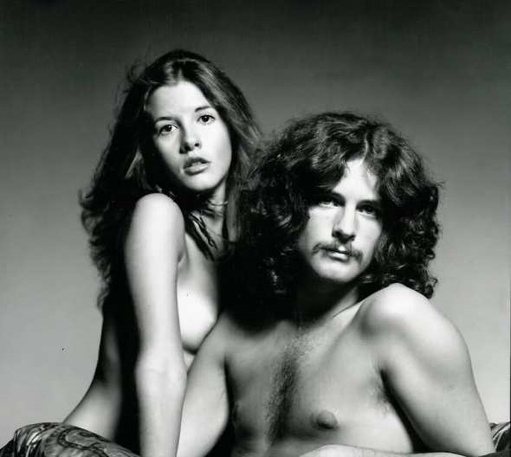
Women in Rock Music
female-led rock groups were rare in the 1950s – 70s, yet some female musicians did succeed…. Stevie Nicks
what makes Nicks unique is that she embraced her feminine identity, while working within the constraints of a male-dominated music industry
music journalism continued to represent female artists like Stevie Nicks as sex symbols
Notes:
Optional audio-visual study: Stevie Nicks Interview 1977 Part 1 (source: WarmerMusicVideos), available at https://www.youtube.com/watch?v=S0jzkicnKyw
Image credit: The Biggest Sex Symbols of the 1970s. Available at http://flavorwire.com/525197/the-biggest-sex-symbols-of-the-1970s/view-all, accessed 20 March 2018

Slide 29
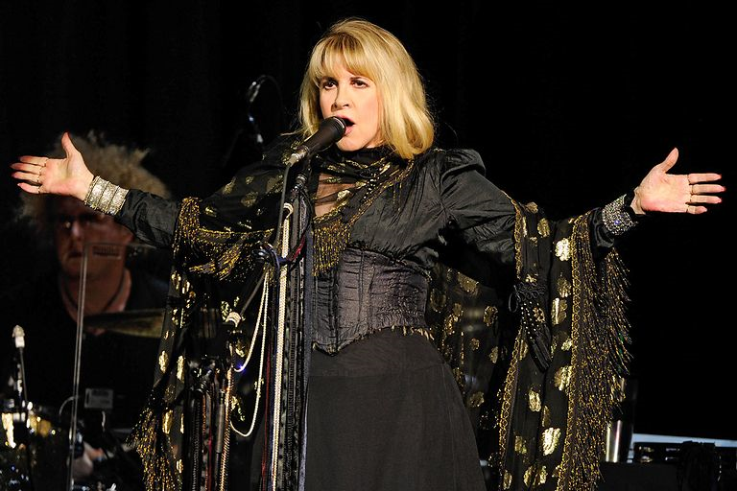
Within the sexist setting and patriarchal media representations of the 1970s, Stevie Nicks displayed female agency and emancipated female sexuality in her songs
‘Rhiannon’ (1975)
‘Gold Dust Woman’ (1976)
‘Sisters of the Moon’
During her subsequent solo career, published articles and interviews often position Nicks as a victim and mentally unstable; popular representations of Nicks as a witch
However, Nicks also represents female empowerment through the celebration of feminine difference within the hegemonic order, subverting patriarchy by adopting an exaggerated femininity, and by finding empowerment in “spiritual feminism”.
Stevie Nicks has been a strong female artist within a patriarchal media that sought to render her a victim of sexist evaluations.
Notes:
Optional audio-visual study: Fleetwood Mac: Don’t Stop (2009)
Image credit: Ariel LeBeau and Jatnna Nuñez. 2016. 20 Spellbinding Singers Who Might Be Witches. Available at https://www.fuse.tv/galleries/2013/10/musicians-who-might-be-witches-photo-gallery#20, accessed 20 March 2018.

Slide 30
The Singer-Songwriter
One noticeable success route for women at the time was that of the singer-songwriter or “folkie lady”, often being “long-haired, pure-voiced [and] self-accompanied on acoustic guitar” (Frith and McRobbie 1978:144), including musicians like Joan Baez and Joni Mitchell.
Notes:
Weblink for optional further reading: Alexandra Pollard. 2015. Why are only women described as ‘confessional’ singer-songwriters? Available at https://www.theguardian.com/music/2015/apr/09/why-are-only-women-described-as-confessional-singer-songwriters, accessed 20 March 2018.

Slide 31
The popularity in folk and singer-songwriter music of the early 1970s worked positively to include female participation within the rock music industry, however by working within a “gentle” and “passive” music genre, female singer-songwriters were marketed as passive and easily controlled by the male gaze, thereby ascribing to patriarchal characteristics of femininity.
The discourses produced by record companies and journalists surrounding these women is markedly different to those surrounding their male counterparts, and work actively to discredit the authenticity of female musicians.
Notes:
Optional audio-visual study: Joni Mitchell: Woman of Heart and Mind (2003)

Slide 32
conclusions
Since the birth of rock music in the 1950s, women were positioned as the other in the male-dominated music industry which sought to diminish female creativity.
Fewer women worked as professional musicians and attempted a musical career at the time, while women who were creating music were discursively represented differently to men in order to devalue female creativity and construct “woman” as the other.
Societies around the world, not only in the West, have long histories of patriarchy, which view the qualities that connote value as the ones strongly connected to masculinity, so that men have been constructed as superior to women.

