Slide 1
Session 6
Globalization and World Music

Slide 2
synopsis
This session is rooted in the 1980s when many music consumers in the west yearned for new, more authentic and meaningful music as rock and punk’s appeal began to wane and popular culture was dominated by a glitzy, artificial world of chart-friendly pop. The “new” soundtrack of globalization was the commercial pseudo-genre of World Music, which was constructed on notions surrounding authenticity, difference, and otherness. Using the notion of genre as a sociocultural framework, the World Music genre is seen here as a sub-field referring to specific musical and extra-musical conventions that are pertaining primarily to the sphere of production. The branding of World Music illustrates the way that popular music is organized and maintained as genres as a means for music industries to streamline production, and as a source of pleasure or identification for audiences and consumers. The commodification practices surrounding World Music discourses were shaped by concepts of authenticity, difference, and otherness. Genre is thereby a constructed, flux concept, and this is well illustrated by how and why musicians become constructed and (in some cases) successful as World Music stars within the World Music brand. Commercial interests in World Music were characterized by a certain academicism among consumers coupled with a “serious” educational interest in the music cultures they encountered, thereby distinguishing themselves from others through their specialized musical knowledge and cultural interests in more “authentic” musics. Yet World Music is characteristic of both hybridity and authenticity, which resembles some kind of paradox between the mixing of musical styles, on the one hand, and a desire to leave a musical “tradition” intact, on the other. Artists who “make it” as World Music stars must therefore navigate carefully between hybridity and authenticity, western consumers’ ideas and expectations of “authentic hybridity”.

Slide 3
Introduction
major cities around the globe witnessed the emergence of local centers of musical production and distribution
local music producers provided marginal markets and “raw” musical material for international music consumption
a new commercial pseudo-genre of World Music emerged, “the soundtrack to the most recent regime of globalization” (Taylor 2014:194).
Notes:
During the 1980s, major cities around the globe witnessed the emergence of local centers of musical production and distribution, recording and disseminating music styles that are globalized, allowing local music and stars to acquire a new legitimacy via new standards of professionalism. Most of this music had little or no direct influence on the Western marketplace.
Yet this began to change, marked by a trend of wholesale migration of music recording industries to Europe, notably to Britain and France, where recordings of world musicians were made and marketed to western enthusiasts and diasporic migrants. An important milestone in this international influence and musical interchange commercially was the Beatles’ promotional relationship with Indian sitar player Ravi Shankar in the 1960s, as well as the Token’s rock n roll hit “The Lion Sleeps Tonight” (Number One in 1961), which sparked a growing interest among western musicians and audiences in “unusual” musical sounds from other parts of the world.
The growing interest in foreign music cultures by western artists and audiences eventually gave way to the emergence of a new commercial pseudo-genre of World Music, “the soundtrack to the most recent regime of globalization” (Taylor 2014:194). World Music manifests the processes and dynamics of globalization, as is has grown out of waves of cultural exchange, movement, and appropriation.

Slide 4
THE BIRTH OF WORLD MUSIC IN BRITAIN
“At the dawn of the 80s, in an age of spandex and synthesizers, many music fans were becoming bored with the pop charts and hungered for a new music that could excite them once again. Where music from the rest of the world had once been regarded as mere exotica, there was increasingly a sense that world music could be the future of pop music.” (Cooper, Hobson and Hobson 2012)
first WOMAD festival in July 1982
radio broadcasters, notably Alexis Korner, Charlie Gillett, John Peel, and Andy Kershaw
Notes:
In 1980s’ Britain, popular music was dominated by the glitzy, artificial world of chart-friendly pop. Audiences and musicians both looked for fresh and new music that was not mainstream or overtly commercial.
A spark of interest and new curiosity about the world’s cultures was ignited, as more distinct and specialized music emerged alongside rapid growth in product range and promotional support by both the recording and aligned entertainment industries, as well as Labour government support. At the same time, some radio broadcasters, notably Alexis Korner, Charlie Gillett, John Peel, and Andy Kershaw began to venture into new musical territory, with “eclectic playlists including a diverse range of African, Latin, and Caribbean music” (Arts Council England 2005:5).

Slide 5
This growing interest in new sounds coincided with a celebration of multiculturalism, promoted at government level under Labour
Race Relations Act (1976) and created the Commission for Racial Equality
multicultural touring circuits, the AMC (Asian Music Circuit) and ACMC (African and Caribbean Music Circuit)
funding organization Visiting Arts; funding by Arts Council England
Arts Worldwide
Notes:
This growing interest in new sounds coincided with a celebration of multiculturalism, promoted at government level under Labour, who, in response to the increase in racism in the 1960s and 70s, passed the Race Relations Act (1976) and created the Commission for Racial Equality. UK cultural policy began to actively promote multicultural arts and music.
The promotional organization Arts Worldwide brought non-mainstream international artists, mostly from Africa, to tour in the UK. Arts Worldwide also decided to release records by the world music artists they had brought over due to the growing demand for recordings from the concert-going public. The label World Circuit Limited was born, and Nick Gold got the job of overseeing the recording projects.

Slide 6
Small, independent record labels emerged, including Stern, Globestyle, Earthworks, Cooking Vinyl, and World Circuit, and a few records broke through to the mainstream, notably Le Mystere des Voix Bulgares (1986) and Paul Simon’s Graceland (1986).
worldbeat, ethnobeat, ethnic, international pop, international folk, roots, tropical, and of course, world music, to name but a few.
This development ultimately led to the birth of World Music as a commercial genre, which is tied closely to the economic, social, cultural, and technological manifestations of globalization (White 2012:1).
Notes:
By the mid-1980s, there existed a small, but vibrant scene of enthusiasts and organizations who
had adopted a range of terms to describe the music they recorded and promoted: worldbeat, ethnobeat, ethnic, international pop, international folk, roots, tropical, and of course, world music, to name but a few. Confusion in the sector led to confusion in the record stores. Haphazard cataloguing made it difficult for the increasing number of record buyers to find or browse CDs of international music. Some kind of standardization was needed. (Arts Council England 2005:7)
This development ultimately led to the birth of World Music as a commercial genre, which is tied closely to the economic, social, cultural, and technological manifestations of globalization (White 2012:1).
It was during the 1980s that world music became more thoroughly approached from the global music industry perspective, which mirrors the emergence of a new commercial genre in Britain – World Music – as it was driven primarily by marketing concerns.

Slide 7
Roger [Armstrong; GlobeStyle] felt that the main problem in selling our kind of material lay with the U.K. retail outlets and specifically the fact that they did not know how to rack it coherently. This discouraged them from stocking the material in any depth and made it more difficult for the record buyers to become acquainted with our catalogues. The initial purpose of the meeting was to encourage the retail trade via various concerted efforts as follows. 1. It was agreed that we should create a generic name under which our type of catalogue could be labelled in order to focus attention on what we do. We discussed various names for our type of music(s) and on a show of hands “World Music” was agreed as the “banner” under which we would work. Other suggestions were “World Beat”, “Hot…”, “Tropical…” and various others. It was suggested that all of the labels present would use “World Music” on their record sleeves (to give a clear indication of the “File Under…” destination) and also on all publicity material etc. […] 2. A representative of each record company present spoke about their various methods and problems with distribution. […] 3. Five possible sales devices were discussed. They are as follows: a. Browser card containing “World Music” heading and individual logos of companies involved; b. NME “World Music” cassettes to which each company would contribute material; c. Music Week advertorial; d. Counter leaflets/joint Catalogue/Poster; e. Hiring a joint PR; f. World Music chart. […] It was also suggested that Andy Kershaw might be persuaded to do a run down of this chart on his show regularly. This whole campaign would start mid-September and run through October, which would be designated World Music month. […] (fRoots 2000)

Slide 8
At a meeting on the 29th June ‘87, representatives from most of the main independent record labels dealing with international/roots music discussed ways of achieving a greater awareness of their music in the retail trade, in the press, and among the public. One of the problems perceived as hindering the development of this music is the haphazard racking of the records in the shops. As the labels concerned have a very wide spread of music in their catalogues, many shops willing to stock this material could benefit from expert advice about this specialised (but not specialist) music. It was agreed that the term WORLD MUSIC would be used by all labels present to offer a new and unifying category for shop racking, press releases, publicity handouts and “file under...” suggestions. This means that you no longer have to worry about where to put those new Yemenite pop, Bulgarian choir, Zairean soukous or Gambian kora records. We shall be making October “WORLD MUSIC” month, heralded by an NME cassette, a dealer campaign and extensive promotion and advertising in the popular press. (Press Release 01 - World Music 2000)
Notes:
Besides deciding on how the CDs should be racked, the meeting’s participants also agreed to share the fees toward a marketing consultant and costs for creating CD dividers labelled “World Music”, which proved to be hugely successful, as record shops now had a convenient category to rack the most diverse “exotic” recordings. The accompanying press release summarized the meeting as follows:

Slide 9
During the 1980s: pop star collaboration and curation
The 1990s saw increasing marketplace success of World Music
The noughties gave rise to an even wider range of venues, festivals and events, including melas and carnevals designated to world, traditional, folk, and culturally diverse musics in the UK, along with media promotion and the new Award for World Music (2002)
Notes:
Asian dance music continued to grow with “stars like Apache Indian, State of Bengal, and Asian Dub Foundation, who made their first appearance in the UK Pop Charts” (Arts Council England 2005:10). The growing British Asian underground scene has rivalled Ibiza’s dance club scene with ease.
World Music continued to be promoted via the media, notably by BBC Radio 3 presenters Andy Kershaw, Lucy Durán, Verity Sharp, and Fiona Talkington, as well as through the creation in 2002 of the Award for World Music. Many mainstream artists continue to take inspiration from World Music, notably Damien Albarn (Blur, Gorillaz) and Robert Plant (Led Zeppelin), “being the most high-profile new converts” (Arts Council England 2005:13).

Slide 10
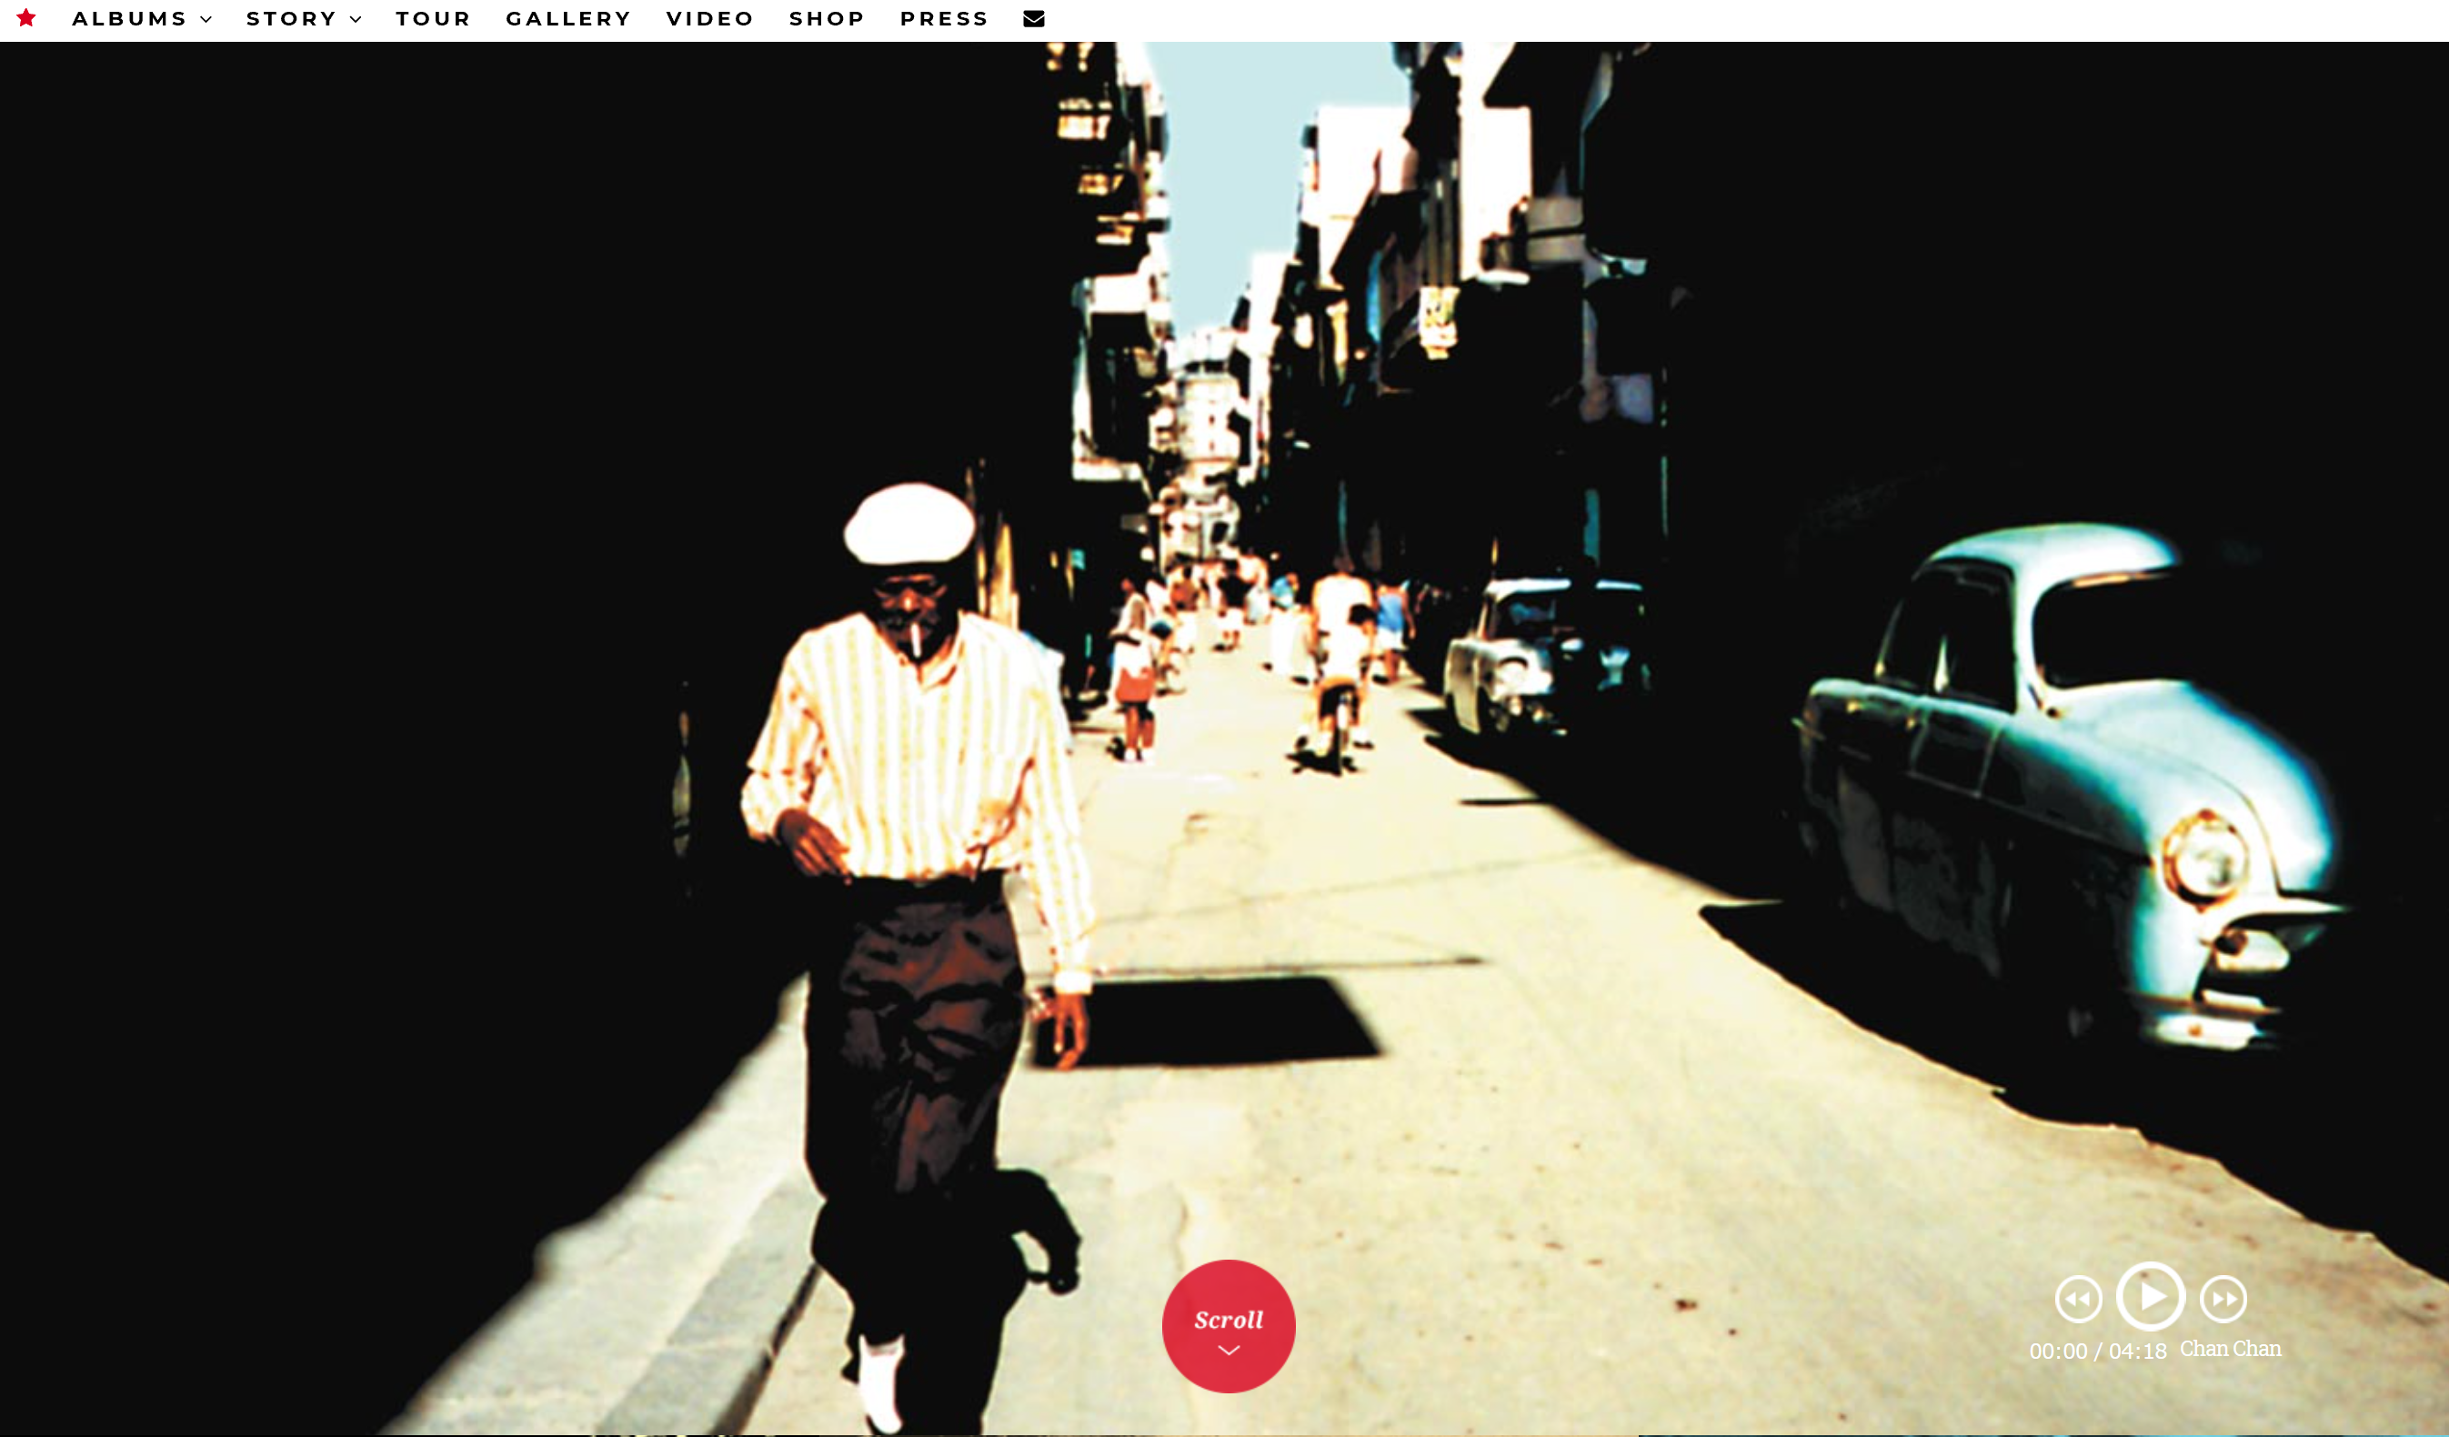
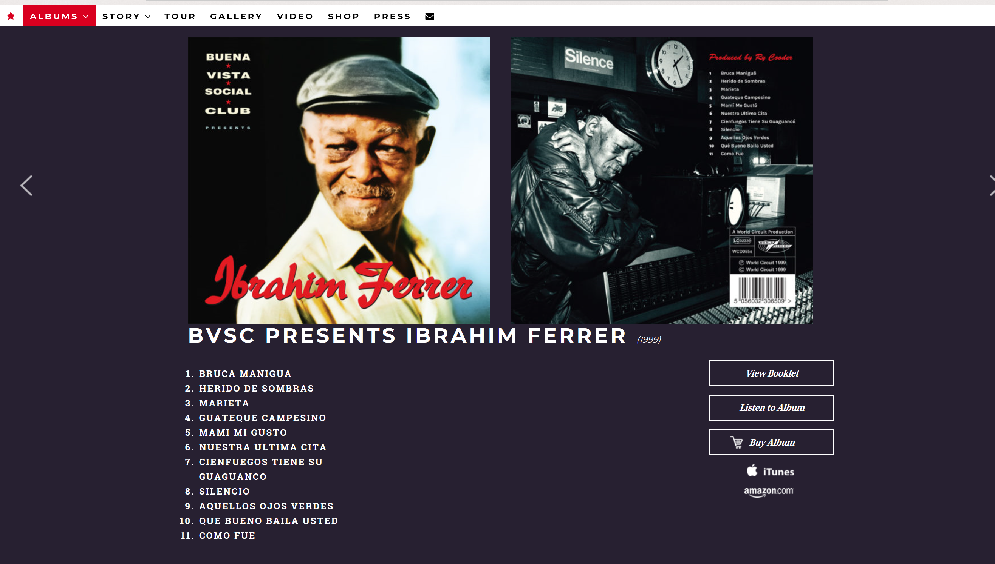
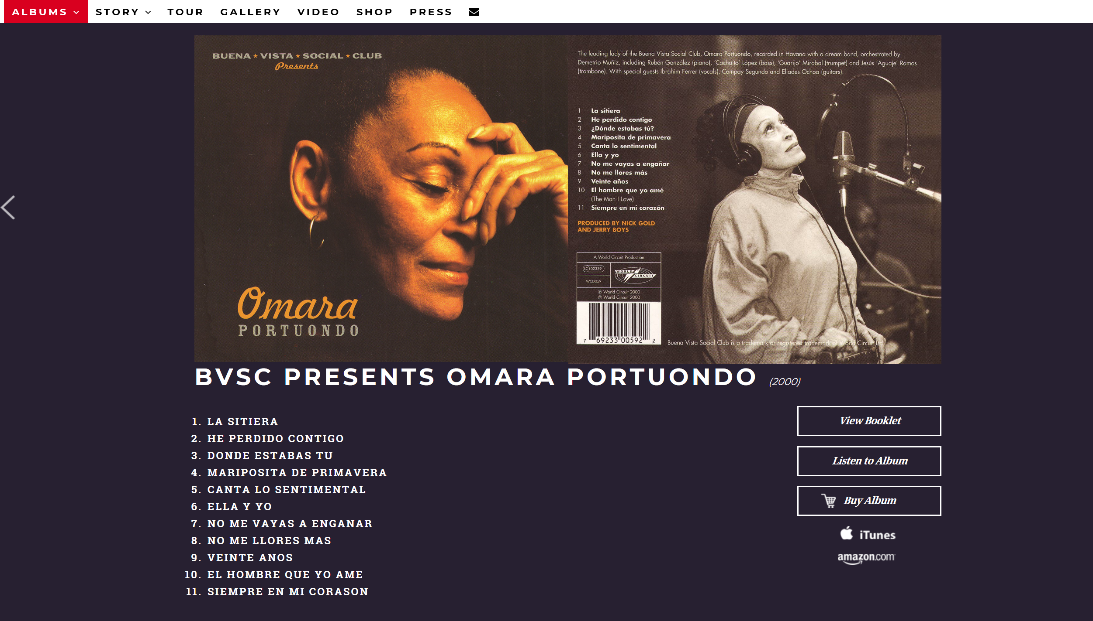
The Brand-warehouse of world music
Notes:
World Music, or certain kinds of music within World Music, provide an interesting example of branding. Tim Taylor provides a useful term to describe World Music as a “‘brand warehouse’ of “world music”’ (2016:93), with its own record labels, sections in record stores, radio and television programmes, magazines, internet sites, book publications, festivals, music tourism (e.g. Songlines Music Travel), and more.
An interesting example is World Circuit’s “Buena Vista Social Club” brand, which signifies an unmistakably Cuban music subgenre within World Music by distinguishing its individual artists’ releases with a recognizable brand name like “Buena Vista Social Club Presents Ibrahim Ferrer”, or “Buena Vista Social Club Presents Omara Portuondo”, which conjures a romantic exoticism and emphasizes a back story that is not easily forgettable (Sisario 2006). “Buena Vista Social Club” plays on the fraternity of nostalgia in “a lost musical paradise”, while the film behind the music centers around remembrance and rediscovery, which made the music ever more appealing (Sisario 2006). In other words,
through repackaging Cuba’s abandoned musical past, it presented a very different country… In an age of increasing globalisation, the feeling of stepping into a world on the verge of disappearance seemed irresistible. The worldwide success of Buena Vista Social Club showed how music from other cultures could be presented to a global audience. It was no longer enough to have the right sound. (How to be a World Music Star 2013: 1:05)
Image credits: Screenshots from the official BVSC website. Available at http://www.buenavistasocialclub.com/, accessed 22 March 2018.

Slide 11
Music brands play important roles for marketing and commercialism, which are often manipulated in such a way as to tap into the beliefs and pleasures of consumers so as to resonate with their identity:
The ideology of identity has become a potent way for many to attempt to ground themselves and to differentiate themselves from others [which] is accomplished through the consumption of certain means of communication and not others, ensembles of commodities and not others, as in that brand of shoes, that brand of shirt, that style of haircut, that brand of cellular phone – that is the primary means of fashioning identities today. The consumption of music is part of this project of identity construction, and for some social groups, particularly youth, a potent part. (Taylor 2016:66-67) […] One consumes goods to make oneself; one even consumes other modes of selfhood to make oneself as a way of demonstrating one’s agential selfhood to oneself and others. (Taylor 2016:69)
A music brand concerns the “whole” musical experience, including sound, visuals, lyrics/language, performance style, and behavioral norms.
Notes:
Music brands play important roles for marketing and commercialism, which are often manipulated in such a way as to tap into the beliefs and pleasures of consumers so as to resonate with their identity.
The ideology of identity has become a potent way for many to attempt to ground themselves and to differentiate themselves from others [which] is accomplished through the consumption of certain means of communication and not others, ensembles of commodities and not others, as in that brand of shoes, that brand of shirt, that style of haircut, that brand of cellular phone – that is the primary means of fashioning identities today. The consumption of music is part of this project of identity construction, and for some social groups, particularly youth, a potent part. (Taylor 2016:66-67) […] One consumes goods to make oneself; one even consumes other modes of selfhood to make oneself as a way of demonstrating one’s agential selfhood to oneself and others. (Taylor 2016:69)

Slide 12
Authentic Hybridity
The genre conventions for World Music are not prescribed to subject matter alone (even though it does play a large part), but an important role is also played by ideas surrounding authenticity.
Branding World Music, or some kinds of music within the genre, as authentic means for artists “to appear in native garb, whether or not they actually wear those clothes outside the concert hall” (Taylor 2014:197).
World Music as “educational music”
Notes:
The genre conventions for World Music are not prescribed to subject matter alone (even though it does play a large part), but an important role is also played by ideas surrounding authenticity. To put it simply, a World Music artist is as such accepted by critics and audiences if these in turn perceive the musician and her/his music to be an authentic representation of the culture from which she/he hails.
Authenticity is thereby constructed and maintained through musical and extramusical activity that includes image and visual style (e.g. iconography and record cover format), rules of behavior and etiquette (e.g. the locale and structure of performances or concerts, or the dress, make-up and hair styles adopted by performers and consumers), language, proxemics, and kinesic codes (e.g. non-linguistic bodily movements), and so forth. Such musical and extramusical practices resonate with the musical tastes and preferences of the audiences of World Music, marked by class, age, gender, and ethnicity, who in turn ascribe certain meaning and value to the musics they listen to and consume.
Since its conception, World Music is thus often packaged and presented to its Western consumers as an educational cultural experience. World Music is usually promoted via displays of expertise, evident in lengthy explanations and descriptions of the music and cultural context inside sleeve notes, and thereby marketed for “proper” appreciation that assumes some kind of academicism from the consumer. Similarly, Morley describes world music as “something that was packaged and presented as educational, as something you visited, if at all, out of a sense of duty” (2010). World Music has thus connotations with educational music. In turn, the “serious” World Music consumer seeks an “authentic” musical experience, whereby the music must be “true” to its own origins and not be hampered by Western commercial interests. I

Slide 13
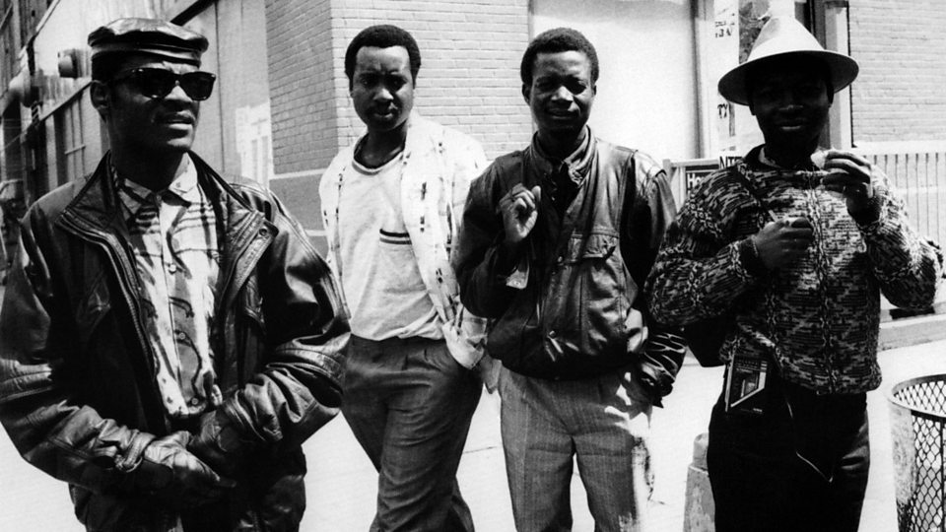
COMMODIFIED AUTHENTICITY
Notes:
A good example to exemplify the commodification of authenticity in World Music is the Bhundu Boys, who are perhaps one of the earliest non-Western artists to achieve commercial success in Europe.
Their sound was signified by a cross-fertilization of traditional African rhythms and Western guitar pop before being introduced to the British music market, but it was still considered to be “based on tradition, although the music would have been ‘modernized’ to some degree as a result of structural and contextual changes” (Brusila 2001:40). The fact that they also maintained African traditions meant that the Bhundu Boys were “both accessible and authentic at the same time” (ibid.:55), whereby authenticity was understood within the context of the rock discourse of the 1980s: “A combination of simple raw talent and hard work [combined with] the general approach to music-making… congruent with the guitar band aesthetics common among indie and roots enthusiasts” (Brusila 2001:40-41). Upon pressures from the media to name their musical style, the Bhundu Boys called it jit, and so they became known as a jit band or jit jive band in Britain.
After their early success, the Bhundu Boys signed a lucrative deal in 1987 with one of the major transnational companies, WEA (Warner). Their sound became heavily commercialized for a mainstream taste, with the resulting album True Jit (1987) featuring a pop song format with more polished Westernized sound, English lyrics, brass sections, and pastiches of the band’s glossy visual image.
Despite WEA’s attempt to market the Bhundu Boys for Western tastes, the album True Jit (1987) did not resonate with the expectations of the audience, and was poorly received by British critics and the public. For instance, “the media’s response was either confused or outright negative. Some writers did accept the record as the product that the band wanted to make…. However, particularly the British ‘roots’ media wanted to distance itself totally from the band’s new style” (Brusila 2001:46).
The Bhundu Boys recorded a second album with WEA, Pamberi (1989), which was a deliberate attempt to return to the “roots” music style of their earlier recordings combined with features of progressive pop, and which received more favourable responses in the World Music media. Yet after the failure of True Jit, WEA’s interest in the band had waned, and so their contract with WEA ended in January 1990 after only two and a half years.
In the World Music media, the Bhundu Boys became a symbol of the banalyzing influences of modern pop, technology, and westernization.
Optional audio-visual study: How to be a World Music Star (BBC 4 Documentary)
Further optional study/image credit: https://www.bbc.co.uk/music/artists/11fe85b6-8be3-4b15-a738-7a268061918b, accessed 22 March 2018

Slide 14
The discourse of world music, anchored in the self-definition of the “West”, tends to portray the musicians as “Others”, that is, as representing the “Rest”. Thus, the musicians and their music come to signify something that has been lost in the more “modern” West. The key to an artist’s success in the world music market seems to be a successful negotiation of the tensions that these expectations create. In order to please the Western audience, the artist must be both accessible and “authentic” at the same time…. What is most important is not how truthfully the musical structure follows some “traditional” style, which would be explained to be “pure”. Instead, the crucial issue is to what extent the music fits the Western listeners’ ideas of what makes the music genuine instead of corrupt and this validation depends largely on the listeners’ own cultural background. (Brusila 2001:52, emphasis in original)
Notes:
Clearly, the Bhundu Boys achieved success in the British independent music market early on when they were representative of their country by adhering to their “original” sound (even if somewhat westernized), and by doing so maintained their national identity and, with it, authenticity. This example shows that: [quote]

Slide 15
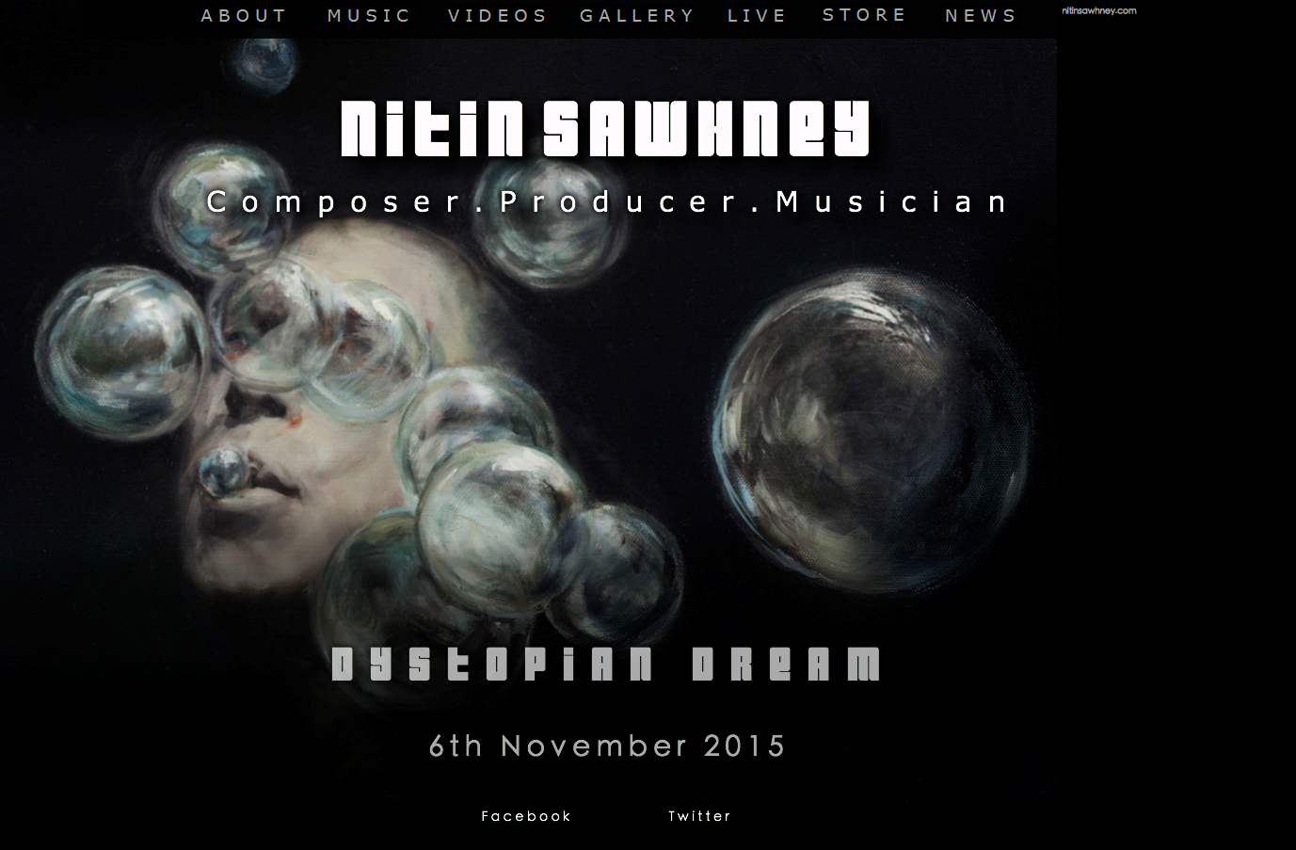
DIASPORIC WORLD MUSIC
Besides questions surrounding, what Taylor termed, “authenticities of positionality, emotionality, and primality” in World Music of the 1980s and early 1990s (Taylor 2016:90), more current World Music often draws on authenticity of emotionality, and thus “raw emotions that people… are thought to possess and express in their music” (91), alongside other strategies for its success.
Nitin Sawhney… the diasporic world musician
Notes:
Besides questions surrounding, what Taylor termed, “authenticities of positionality, emotionality, and primality” in World Music of the 1980s and early 1990s (Taylor 2016:90), more current World Music often draws on authenticity of emotionality, and thus “raw emotions that people… are thought to possess and express in their music” (91), alongside other strategies for its success.
A good example of authenticity of emotionality is Nitin Sawhney, a diasporic Indian-British producer and composer who incorporates musical styles from around the world in his music.
Nitin Sawhney incorporates a vast repertoire of styles into his compositions, including Asian influences, jazz, dance music, classical music (e.g. Bach), and Bollywood. By fusing influences from Asia and Europe, the music is made far more accessible to western (often diasporic, cosmopolitan) consumers, and thus tends to do well in the World Music market. His song “Nadia” (1999), for example, features a Drum n Bass rhythm complemented by a female vocalist singing Indian raga.
Musical expressions of diasporic experiences often exert certain themes that relate to the social situation of migrant people. Multiculturalism, spirituality, and politics are all prominent narratives in diasporic World Music. Addressing emotional themes of belonging becomes a vehicle for imagining a sense of place to supplant the condition of placelessness.
This can be seen in Sawhney’s song “Immigrant” (1999) : Will you take me there, to a distant place I've never been before, I could leave this world, I could follow you like oceans to the shore. Meanwhile, collaborations with Paul McCartney, Norah Jones, and Nusrat Fateh Ali Khan helped Nitin Sawhney to build bridges to the western mainstream.
Further optional study:
Nitin Sawhney official website. Available at http://nitinsawhney.com/
BBC Profile. Available at https://www.bbc.co.uk/music/artists/bc3d74c5-9328-4a1b-8014-3ecdb3dababe, accessed 22 March 2018
Audio-visual study:
Nitin Sawhney ‘Nadia’ (1999) [YouTube video] https://www.youtube.com/watch?v=4jJJHfL1yQA
‘Immigrant’ (1999) [YouTube video] https://www.youtube.com/watch?v=piRac0XDJIY&list=PL8eZfpZHCCFMCl6zb5hzoQkRs9QjgQSHh

Slide 17
The examples illustrate the role played by the constructed concept of authenticity in World Music
The western star system is clearly rooted economically
“stars” are products of the market, yet at the same time also possess unique, distinctive talents, personalities, or musical characteristics.
Notes:
The above examples illustrate the role played by the constructed concept of authenticity in World Music, which often determines whether a musician or group achieves success and becomes a “star” in the western World Music or (even) mainstream pop music industry. The western star system is clearly rooted economically and based on the current oligopolization of the music industry, in which a selected number of artists generate the majority of revenue. In this system, “stars” are often musicians, whose past sales are taken into account to guarantee the success of future deals (Frith et al. 2001:35). They are products of the market, yet at the same time also possess unique, distinctive talents, personalities, or musical characteristics.

Slide 18
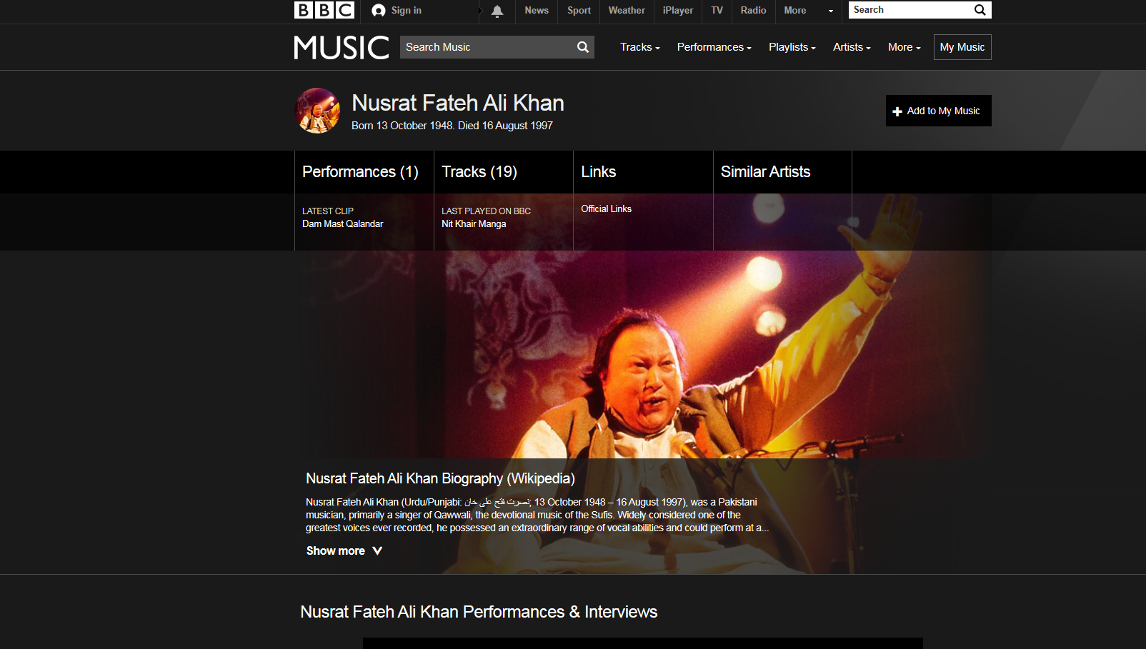
THE VIRTUOSIC WORLD MUSIC GENIUS
Notes:
The musical career of Nusrath Fateh Ali Khan serves as another example of the formation of a World Music star and his introduction in western culture. Nusrath Fateh Ali Khan was a famous Pakistani singer known for his aptitudes in traditional Qawwali music, a devotional, religious musical genre from the Indian subcontinent that shares characteristics with classical music of Pakistan.
Despite its religious functions, Khan successfully established qawwali in secular, western markets, and aided in its “transformation from an ‘exclusive’ art form into a ‘popular’ form of entertainment” (Mirza 1986:189). His significance remained within Asian cultures until his appearance at the World of Music, Art and Dance festival (WOMAD) in 1985, after which Khan achieved popularity among Western audiences.
Khan’s success as a qawwali singer in both Western and non-Western circles is revealed in the “ritual of solo performance”, the exaggerated, extreme nature of performance. The spectacle of Khan as the solo qawwali vocalist (although accompanied by a group of qawwali singers) is coupled with his demonstration of virtuosity, which left his new audience speechless. Khan’s performances have often been described as transcendental, by which he communicated directly with the “soul” of his listeners via their senses.
Khan epitomizes the notion of the “virtuosic genius” by the way in which he wao-ed his audiences by way of sheer vocal mastery, executive ability, superhuman technique, and endless improvisation, even though Khan’s virtuosity posits a qualitatively different mode of rarified performance than was common among the extrovert virtuosi of the romantic era, and through which Khan acquired the personae of the divine messenger of qawwali music.
Meanwhile, collaboration with recognized performers, such as Peter Gabriel, was key to the establishment of Khan as an authentic World Music artist, as people who appreciate and support Gabriel’s musical career trust his judgments regarding new artists and genres.
In 1990, Khan was approached by the Real World label’s producer, Michael Brook, to begin work on his first collaboration album. Khan’s arrangements drifted away from the traditional, incorporating westernized instrumentation, such as mandolin and guitar in order to aid in the introduction and appeal of Khan’s qawwali music to western ears. By altering traditional, scared arrangements, Khan risked misinterpretation of his art as disrespectful, which is exemplified in Khan’s album Musst Musst (1990). Despite this, the album Musst Musst peaked at number fourteen on the Billboard Top Music Album charts in 1991.
Khan’s success may be explained not so much in terms of authenticity by keeping to the tradition of qawwali. Khan sang in his native language, and he seemed to possess the ability to transport listeners in ways that were “liberating and glorious” through his talent alone (Hilburn 1996). At the same time, Khan’s western arrangements appealed to westerners as he was still preserving a traditional or “ethnic” quality.
By 1991, he was an established World Music star, collaborating and performing with artists across the globe. The repetitive, engulfing nature of Khan’s qawwali captured the interest of the emerging UK dance scene, as the culture called for new, distinctive sounds. For instance, British trip-hop group, Massive Attack, one of the most influential British groups of the 1990s, were inspired by Khan’s Musst Musst and subsequently released a commercially hugely successful remix of the track. The commercial success of both the remixed track and the original album inspired British Asian dance producers, such as Talvin Singh, to discover a new musical identity by implementing samples of audio taken from music of their own tradition.
Further optional study: BBC profile. Available at https://www.bbc.co.uk/music/artists/5968383c-11c1-4c5b-ada0-504a38cec8e7, accessed 22 March 2018
Optional audio-visual study:
How to be a World Music Star (BBC 4 Documentary)
The Real World of Peter Gabriel
Ustad Nusrat Fateh Ali Khan – Documentary
Nusrat Fateh Ali Khan: A Voice from Heaven

Slide 19
Before his sudden death in 1997, Nusrath Fateh Ali Khan had developed from WOMAD spectacle to World Music stardom. He provides an interesting example of how experimentation and “incorporation” (Kheshti 2015) of traditional music for western tastes has a significant impact on listeners’ positive reception of such “difficult” music as qawwali. World musicians like Khan both challenge notions of tradition, with the resultant hybridization problematizing the idea of “authentic” World Music.

Slide 20
MOVING BETWEEN CULTURES
Notes:
Youssou N’Dour is a World Music star whose musical career and creative output has been subject to the authenticity debate surrounding World Music. N’Dour had his first success at the age of thirteen performing a song with the Dakar Star Band, the biggest Senegalese band of all, which he joined proper at the age of 16 in 1974.
Initially imitating and performing Cuban-style music, which, like other forms of copyrighted music imitated across Africa, became scorned as “foreign” (Murphy 2007:46), the Star Band increasingly Africanized their music during the 1970s by introducing more percussion instruments, specifically the local tama talking drum, among other types of drums. Renamed Super Etoile de Dakar and subsequently Super Etoile, the band coined the musical term mbalax to describe their new blend of Afro-Caribbean music, Western pop, and Wolof folk music.
This music became popularized among local Africans as dance music, while the traditional, and thus authentic, stylistic and musical elements of mbalax are mostly reflected in the complex polyrhythms (performed by the drums) and abrupt tempo changes. This is audible in the continuous, varied repetitions and variations of basic musical units, and successive entries of new instruments or voices. These complex rhythms are marked by shifts of emphasis in bringing out new rhythmic parts and patterns.
Audio-visual study: Youssou N’Dour: Voice of Africa

Slide 21
Notes:
Visually, too, we can note the “Africanized” image of Youssou N’Dour. Both the original (1988) [here left] and re-released (2006) album covers of Immigrés depict the singer behind an earthy background with somewhat rural connotations, wearing a traditional Islamic garment and cap, reflexive of his actual image of a “good non-smoking, non-drinking Muslim [who used to live] with his parents in the Medina quarter in Dakar” where he grew up (RFI Musique 2014). The drum is noteworthy too, instantly signalling the local African rhythms that mark the music of the album. As in the previous example, the lyrics are pivotal too, playing into strong ideas of local identity: Singing in his local Wolof language, N’Dour’s lyrics often invoke Senegalese history and culture, particularly that of his own ethnic group, the Wolof, which has been accredited to his lineage to a long line of griots. Reading the lyrics, we get a sense that N’Dour clearly views himself as a griot, as he engages in story-telling, disseminates news, helps people to understand their world, giving admonitions, and keeping watch (Taylor 2004:151).

Slide 22
Notes:
While N’Dour’s earlier music is clearly a reflection of resistance to cultural homogenization, and thus authenticity, N’Dour turned toward and adapted his music for an international western market in his later career, during which his music became increased marked by westernization to varying levels (Murphy 2007). Although marketed as World Music, his later music reflected N’Dour’s desire to break into the lucrative western music mainstream of international pop in a drive for commercial success.
He secured a record deal with Virgin Records, with whom he released albums like The Lion (1989) and Set (1990). N’Dour gained massive media exposure through his performance with stars like Sting, Tracy Chapman, and Peter Gabriel during the Amnesty International World Tour in 1988; he had already supported Gabriel’s Secret World Live Tour in the US in 1986. Their collaboration continued when Gabriel joined N’Dour on his single “Shaking the Tree” (1990), a track from N’Dour’s album The Lion (1989) released by Virgin Records one year earlier. This album was a hugely expensive undertaking: while mbalax, the Africanized musical style pioneered by N’Dour, was the main driving force, the music was combined with synthesizers and sophisticated arrangements requiring the highest tech studios. Critics saw in this album the deformation of his music, as it no longer sounded like an authentic, local expression of cultural identity.
Even while N’Dour was highly popular in the World Music community in the West, his record sales remained modest, upon which Virgin released the contract in April 1991.
Audio-visual study [emdedded YouTube cideo]: Peter Gabriel feat. Youssou N’Dour 2005 ‘In Your Eyes’. Available at http://www.youtube.com/watch?v=WGao0UZmHpU, accessed 22 March 2018

Slide 23
Notes:
N’Dour was subsequently offered a record deal by Sony, who released the single “Seven Seconds”, a duet with Neneh Cherry. The song is an atmospheric and international pop tune. It features no particularly African sound in that it is devoid of the musical trademarks of Senegalese mbalax, even though N’Dour sings parts of the lyrics in the Wolof language. The song was a commercial hit worldwide (with 1.5 million copies sold), through which N’Dour became known to the Western general public and those who would usually be more attracted to British and American music.
The song reflects how music becomes altered in style beyond recognition and devoid of any local and national distinctiveness. It enabled N’Dour to break through on the international scene, which benefited his subsequent album Wommat [The Guide] (1994), as it quickly entered the European charts and markets outside of Africa.
Audio-visual study: Youssou N’Dour ‘7 Seconds’ (featuring Neneh Cherry) [YouTube video]. Available at https://youtu.be/wqCpjFMvz-k, accessed 22 March 2018.

Slide 24
Notes:
His 2000 album entitled Joko: From Village to Town is similarly aimed at the international market, features contributions from guest stars including Peter Gabriel and Sting. In this album, N’Dour makes the most significant alterations to his music in a continued attempt to break into the Western mainstream music market. The music is heavily produced and based on steady, regular rhythms, synthesizers, and toned-down vocals.
The album cover art for Joko: From Village to Town (2000) is noteworthy too: Behind a grey background, which is set off by modern graphic effects in red tones, the cover depicts a close-up, frontal shot of the musician’s face that stares directly at us, giving a feeling of confrontation and assertiveness. N’Dour’s face is somewhat whitened, playing down his “blackness” and reflecting a more artificial (instead of natural) light. The musician’s assertive facial expression, together with the use of colors and lighting evoke a sense that N’Dour is a “modern” musician. Visually, it reflects the influences of urbanism and modernity that characterize the music on this album.
Youssou N’Dour provides a fascinating example of the ways in which musicians often willingly alter their style, even beyond recognition, to translate his music for the West so as to break into the lucrative music mainstream of international pop.
David Murphy (2007) shows that alongside the music marketed to consumers and audiences in the West, N’Dour also maintained different repertoires aimed at Africans in local markets. While N’Dour was keen to achieve a global, increasingly homogenized, soft rock style aimed at Western audiences, he was also prone to maintain a local Afropop music that resonated with the experiences, beliefs, and concepts of the Senegalese people.
I wouldn’t want to define myself. But there are two ways I see myself. One is to appeal to my African audience and the second is to leave myself open to other influences and other cultures. (Youssou N’Dour, quoted in Taylor 1997:136)

Slide 25
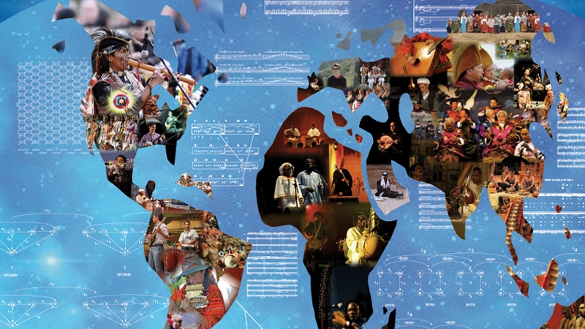
Notes:
The rise of the commercial category of World Music in the west epitomizes the development of globalization and, with it, debates on commodification, power, and identity. Situated in multiple cultural and economic networks, some World Music artists reinvent and revive traditions, others stir national political consciousness or contribute to political movements, while many seek to achieve commercial success. As a product of cultural and economic globalization, World Music is a contemporary cultural expression entangled in both hybridity and authenticity. As a commercial product, World Music is a powerful illustration of the complex ways that the global and the local are articulated, manipulated, contested, and constructed. Meanwhile, some World Music has acquired a sense of “coolness” in neoliberal culture, a word that is ubiquitously used presently around the world. Coolness is a sensibility now widely embedded and at the very heart of mainstream (world) popular culture under neoliberal capitalism.
Image credit: Third International Conference on Analytical Approaches to World Music. Available at http://aawmconference.com/, accessed 22 March 2018.

