Slide 1
Session 7
The Cool Culture of Neoliberal Capitalism

Slide 2
synopsis
This session explores the way that popular music consumption of the noughties became influenced by a new cultural logic—the cool and the hip. We will first explore the origins of cool and establish the idea that neoliberal capitalism is cool capitalism. In the age of neoliberal capitalism, the ideology of cool determines cultural production and consumption, and has thereby become the focal point of popular culture globally, influencing a diverse range of contemporary trends and fields from food, music, and fashion, to technology and cinema. The hip and the cool are examples of non-economic forms of value created through branding practices. Coolness has become an incredibly powerful concept within business and marketing. It is a universal motivator for teens and youths, as well as for a large range of other age groups. Coolness excites consumers, adds symbolic value to products, and drives consumer trends. Coolness and consumption are intrinsically linked. Consumption in postmodern popular culture is central to identity formation and acquisition of status—cool, triggering in consumers the desire to achieve a cool lifestyle through consumption. The cool culture of neoliberal capitalism is clearly evident in the branding processes surrounding the “cool celebrity personae”, and the mechanisms of brand extension and brand endorsement..

Slide 3
Introduction
I would now go so far as to put it this way: What is the cultural logic of neoliberal capitalism? It is the hip and the cool. That is, knowledge of the hip and the cool is the source of cultural capital today; and what drives the cultural industries is the production of the hip and the cool. In terms of cultural production, workers frequently use the term “edgy” to describe the sort of work that they want to produce, which, it is hoped, will be thought of as hip or cool by consumers…. To repeat…: I regard the hip/cool/edgy as the cultural logic of neoliberal capitalism (or one cultural logic of neoliberal capitalism, certainly the hegemonic one). (Taylor 2014:195, 197)
Notes:
In the age of neoliberal capitalism, the ideology of cool determines cultural production and consumption. The concept of cool has become a focal point of world popular culture, and is widely acknowledged as a global phenomenon, influencing a diverse range of contemporary trends and fields from food, music, and fashion to technology and cinema (Belk, Tian, and Paavola 2010:186). The ideology of the hip and the cool marks the logic of neoliberal capitalism. Tim Taylor asserts:

Slide 4
“culturati taste leaders” (McGuigan 2016:37)
“new petite bourgeoisie” (Bourdieu 1984) or “new (technocratic) bourgeoisie” (Taylor 2016:64)
They “find what is hip, cool, and edgy and… both promulgate this ideology and employ it to sell anything” (Taylor 2016:63)
“cool seduction”
“human creativity is squeezed by economic considerations” (2016:40)
Notes:
Coolness today is pursued through consumption, and it is a key motivator for teens, youth, and young urban professionals, the “culturati taste leaders” (McGuigan 2016:37), who represent the largest consumer group of popular culture and are the target of the relentless market research practice of coolhunting (McGuigan 2009:110).
This marks a historical shift in the control of cultural capital toward the workers in the cultural industries and, more generally, creative industries, members of a new class, the so-called “new petite bourgeoisie” (Bourdieu 1984) or “new (technocratic) bourgeoisie” (Taylor 2016:64).
Members of this new class are engaged in a struggle for distinction (in the Bourdieuan sense). They “find what is hip, cool, and edgy and… both promulgate this ideology and employ it to sell anything” (Taylor 2016:63).
McGuigan speaks of “cool seduction” in consumer culture to describe the cool rhetoric of advertising today, not dissimilar to Marxian commodity fetishism, to the point that “human creativity is squeezed by economic considerations” (2016:40).
And it is not only cultural commodities produced by the cultural and creative industries (advertising, fashion, film, television, and so on), but the commodities of other industries too that are increasingly culturalized, whereby all sorts of goods become desirable and consumed for their perceived coolness.

Slide 5
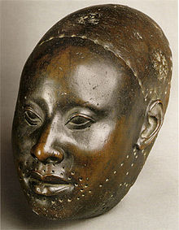
The Origins of Cool
West Africa
US
Coolness is a set of shared meanings, including self-presentation, language, values, and artistic expressions, all of which represent group membership (O’Donnell and Wardlow 2000:13).
Notes:
The word “cool” comes from the West African itutu (“mystic coolness”) to describe composure in battle and emotional control in public community rituals of music and dance.
Literatures suggest that West African cool spread with slavery to the US, where its quality persists until today within the jazz tradition (ibid.:57) and shaped a culture of disaffection in response to discrimination that emerged at the margins of US culture. The cool person, although perpetually alienated, adopts a balancing strategy of combining submission and subversion.
Coolness is a social term directly related to youth and the now that refers to an ironic stance, aloofness, insider knowledge.
Coolness is a combination of three character traits: narcissism, ironic detachment, and hedonism (Pountain and Robins 2000:5). Yet the concept is inherently fluid across time, places, and cultures, and therefore culturally defined and continually changing.

Slide 6
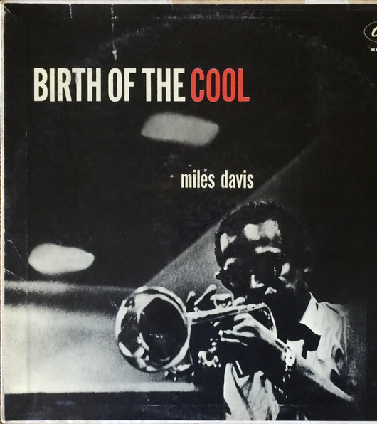
As Ted Giola has noted, the trumpeter Miles Davis, nicknamed “the Prince of Darkness”, epitomised cool with his abrasive attitude towards the audience, particularly the white audience, and his generally detached and even foreboding presence of stage. The 1954 release of the long-playing record Birth of the Cool was pivotal to the spread of studied disaffection amongst hipsters, both black and white. (McGuigan 2016:36)
Notes:
In its evolved form, coolness is intrinsically American. Its evolution as a cultural phenomenon was shaped in the early twentieth century.
The concept of cool converged African-American (the American working-class male) and Anglo-American (the Victorian gentleman) archetypal modes of masculine behaviour, and increasingly shifted to the heroic ideal of the slightly aloof rogue figure of the untameable, self-sufficient male “tough loner” (Dinerstein 2017:8-9, 53). Coolness became a personal stance associated with dignity in oppressive circumstances, which can be located in popular music and literature in the 1920s, particularly Black American jazz culture and later, especially during the mid-twentieth century, also in White jazz circles:
As Ted Giola has noted, the trumpeter Miles Davis, nicknamed “the Prince of Darkness”, epitomised cool with his abrasive attitude towards the audience, particularly the white audience, and his generally detached and even foreboding presence of stage. The 1954 release of the long-playing record Birth of the Cool was pivotal to the spread of studied disaffection amongst hipsters, both black and white. (McGuigan 2016:36)
Image credit: Album cover of Miles Davis’ Birth of the Cool (1957)

Slide 7
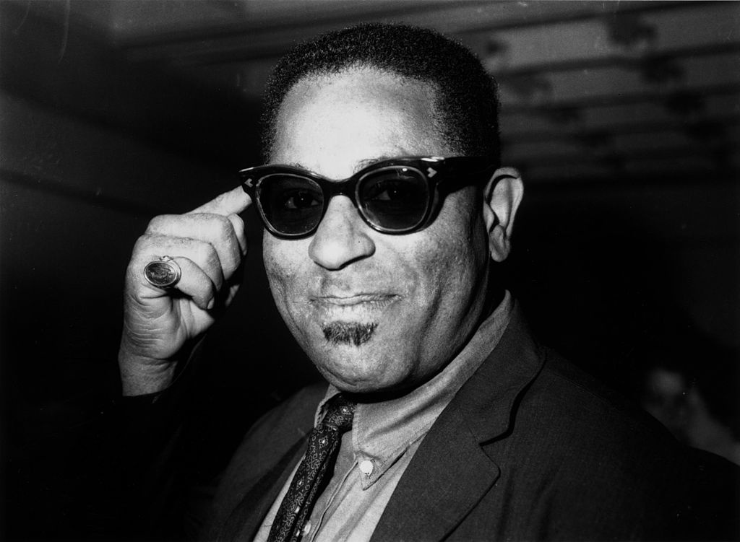
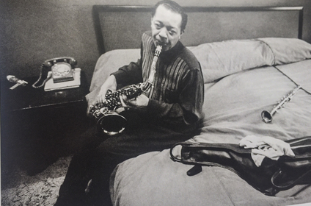
Notes:
Through music, style, slang, humor, and physical gesture, the jazz musician became “global culture’s first non-white rebel”.
Cool Jazz was a black response to the need for black entertainers to mask their feelings and smile in front of whites (“the grinning black mask” (42) or “Tomming” (44)), for example in blackface minstrelsy in the 1870s.
Jazz saxophonist Lester “Pres” Young disseminated the word and concept of cool into jazz culture in the early 1940s. He was the first to use the expression ‘I’m cool’, while rejecting “Tomming” as a means of accommodation to a white social order and as a symbol of black male limitation. Young’s cool self-expression extended to the strategic use of sunglasses (he was the first jazz musician to wear shades on stage). Indeed, wearing sunglasses turns a person into a “cool medium”, creating a sense of visual mystery in the observer (McLuhan 1964:53). In Jazz, specifically,
Sunglasses became a key element of the stylistic rebellion of black jazz musicians in the postwar era; in effect, wearing sunglasses at night was the primary symbol of the cool mask. (Dinerstein 2017:50)
Image credits:
left: Book cover of The Origins of Cool in Postwar America (2017) and Dizzie Gillespie 1963]
middle: Lester Young, available at http://www.joeldinerstein.com/archive/2014/12/10/young, accessed 23 March 2018
right: Dizzie Gillespie, available at https://a.scpr.org/i/a27a307d27b44d58ef1977e227e2cb72/143922-full.jpg, accessed 23 March 2018

Slide 8
1950s coolness… in film noir, Beat literature, and abstract expressionism
1960s cool underground counterculture in rock ‘n’ roll, journalism, film, and African American culture
since the 1980s, cool becomes mainstream in a new capitalist context
Notes:
Coolness as black self-expression and self-presentation in response to the white gaze of superiority quickly spread to other cultural expressions like film noir, Beat literature, and abstract expressionism as a “rebel masculine sensibility”, and by the 1950s, cool came to represent cultural resistance to all authority.
During the 1960s and 70s, cool became the key ingredient to a surging underground, counterculture aesthetic in rock ‘n’ roll, journalism, film, and African American culture, marked by antiauthoritarianism and openness to new ideas (Smithsonian 2014a).
Coolness has since the 1980s entered the mainstream. Rebellion became co-opted and sold as an integral aspect of the cool aesthetic, from highbrow fashion to mass-culture video games, from hip hop to grunge, from skateboarding to the Internet, from street graffiti to MTV. Young black men responded to the appropriation of cool by the dominant white society by recasting it as “chill” and “chillin’” in the early 1980s.

Slide 9
Notes:
Cool figures from the past: Astaire and Rogers in the ‘30s, Brando and Elvis in the ‘50s, Dylan and Hendrix in the ‘60s, Madonna and Prince in the ‘80s, who shaped the new music icons of cool around the world.
Cool spread worldwide through the global impact of musical practices and tastes in western pop-rock music. Representative of the legacies of cool include Bessie Smith, Miles Davis, Billie Holiday, Frank Sinatra, Muddy Waters, Elvis Presley, James Brown, Bob Dylan, Jimi Hendrix, Deborah Harry, Marvin Gaye, Chrissie Hynde, David Byrne, Madonna, Prince, Afrika Bambaataa, Kurt Cobain, Selena, Shawn Carter (Jay-Z), Johnny Cash, and others (Dinerstein 2017:15; Smithsonian 2014b).
Image credit: The Legacies of Cool, available at http://npg.si.edu/exhibit/Cool/legacies.html, accessed 23 March 2018
Further optional reading: American Cool, Smithsonian Institute. Available at http://npg.si.edu/exhibit/Cool/index.html, accessed 23 March 2018

Slide 10
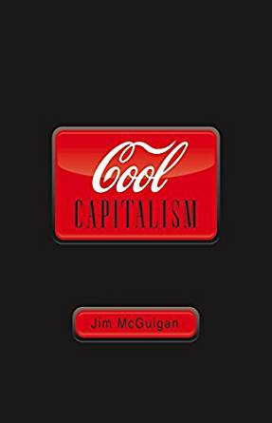
Neoliberal Capitalism as Cool Capitalism
Nike in casual wear and Apple in communication technology… are especially pertinent examples of the culture and political economy of transnational capitalism today, since both have cultivated counter-cultural and rebel brand identities. Such “cool” identities might at one time have been connected to anti-capitalism, but that is no longer so. These rich and powerful corporations are the epitome of cool capitalism. (McGuigan 2016:58-59)
Notes:
In his cool capitalism thesis, Jim McGuigan (2012, 2016) asserts that coolness is both discursive practice and affective code, and a social practice under neoliberal conditions. Cool capitalism means neoliberal capitalism across the globe. Neoliberal capitalism is cool capitalism.
Cool capitalism means consumer culture and cool commodities, marked by cool seduction and acutely brand-aware commodity fetishism.
As a global phenomenon and feature of Americanization, cool capitalism incorporates the signs and symbols disaffection into capitalism itself.
Fashion companies like Nike and The Gap, as well as Steve Jobs’ Apple, for instance, have drawn on counter-cultural themes and symbols to sell their rebel products. These corporations are prime examples of postmodern consumer capitalism.
Image credit: Book cover, Cool Capitalism by Jim McGuigan (2009)

Slide 11
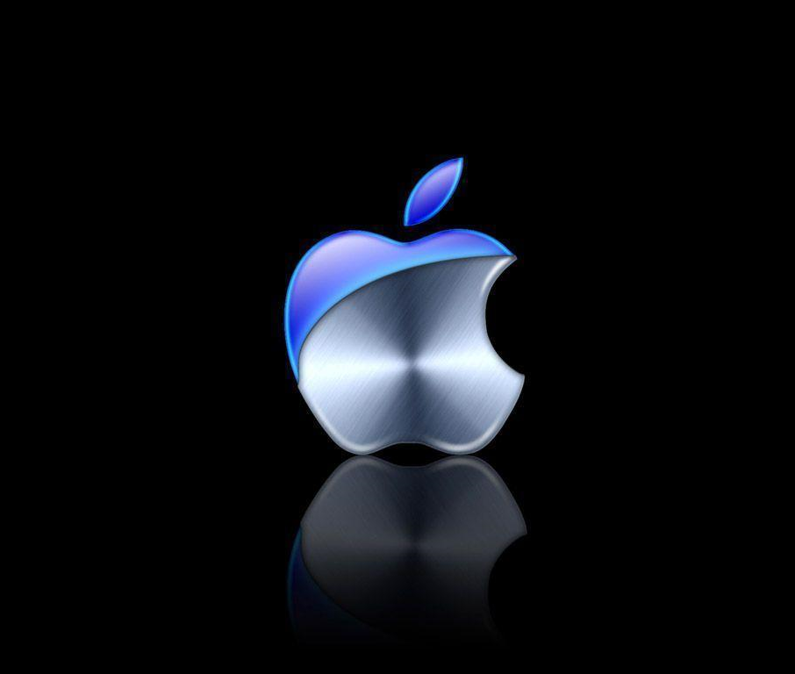
Sample Footer Text
3/23/2018
11
Notes:
More recently, Nike has branched into a new market by developing a performance hijab aimed at Muslim women athletes (Kleinschmidt 2017), a move that is regarded by many Muslim women as the cooption or selling out of this Muslim feminist symbol.
Disaffection, such as left-wing radicalism or Muslim feminism, becomes fused with commercial culture, fashion, and celebrity obsession, which effectively contributes to the neutralization of critical opposition to neoliberal political economy.
Consequently, coolness is projected as a “façade” to contemporary neoliberal culture. The cool façade is made up of seductive symbols and experiences of everyday life and absorbs ostensibly rebellious or non-conformist sentiments. In doing so, dissent or disaffection are, in effect, neutralized.

Slide 12
Branding the Cool Celebrity Personae
A brand seeks to create:
an emotional connection to a product, giving it a real personality, almost so that it becomes a valued and trusted friend [“brand personality”], something known and understood (Taylor 1994:196) [and is] another way of putting something in its place, making it knowable and accessible to potential consumers and creating an emotional connection to it. (Taylor 2016:93)
Notes:
Central to the ideology of cool is branding, which today determines and confers value. Branding plays a critical, if not central, role for all commodities today in a globalized, highly mediated, and neoliberal capitalist economy (Klein 2010). The successful global firm “concentrates on the sole task of developing brand images… just to associate brand names with attractive images, concepts, celebrity figures” (Crouch 2004:37).
Branding has become a central concept in neoliberalism. A brand seeks to create:
an emotional connection to a product, giving it a real personality, almost so that it becomes a valued and trusted friend [“brand personality”], something known and understood (Taylor 1994:196) [and is] another way of putting something in its place, making it knowable and accessible to potential consumers and creating an emotional connection to it. (Taylor 2016:93)

Slide 13
Brand personality
Notes:
In neoliberal capitalism branding has become “a more intense, frequent, and dominant strategy” where every commodity is treated as a brand (Taylor 2016:54). Today vast advertising and marketing industries revolve around what makes a brand attractive and the revenue produced by that brand. They strive to add value to products by establishing brand names and associating them with distinctive characteristics (Montaya and Vandehey 2002:10; Achacoso 2014:9).
The goal is to create a “brand personality” and infuse a product with human characteristics, so that consumers connect emotionally and create lifelong relationships based on love, trust, and belief. It is believed to help consumers to navigate the crowded marketplace, and to identify with the brand by appealing to the senses of touch, taste, hearing, smell, and seeing through its distinct imagery, language, and associations.

Slide 14
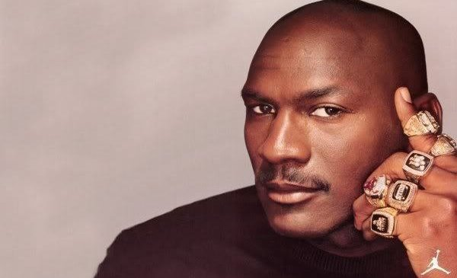
Notes:
Branding around personalities has become increasingly popular over the past twenty years and developed into a dominant concept within marketing. Creating brands around personalities, that is, human brands or “productized celebrity person-brands”, specifically, is highly lucrative in today’s media saturated society (Fournier 2010:38).
Personal brands instantly communicate simple and clear feelings about a product, and underpin important concepts like market positioning, consumer experience, and management of performance. Personal branding is intrinsically linked to our fascination with people, since consumers are most likely to relate to human brands. Personal brands have the effect that consumers seemingly build relationships with celebrities and therefore feel they are not purchasing from a complete stranger, but rather a familiar face (Vesey 2015:1002). Brand personae familiarity is thus important: for consumers to connect with an artist is key in creating “familiarity in an unfamiliar world” (Montoya and Vandekey 2002:4), an essential factor of branding and the reason why it is so powerful.
Image credit:
Nike is known around the world for being one of the most iconic brands. Nike is also very well known for another aspect and that is its consistent use of celebrities to endorse the brand. In fact one of the most successful collaborations between a brand and a celebrity is that of Nike and Michael Jordan (American basketball player).
So successful was the collaboration that Nike and Jordan launched a new brand variant called the Air Jordan line of sport shoes. Source: https://www.brandingstrategyinsider.com/2010/10/celebrity-endorsement-guide.html#.WhXrykpl_IU, accessed 23 March 2018.

Slide 15
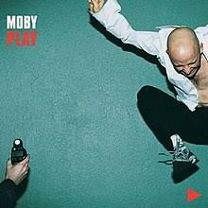
Notes:
There exists a direct link between music and a brand’s income.
The economic value of creating a brand-hit association has been well-known to marketers and advertising agencies. The earliest use of music to sell products was in the early twentieth century through jingles, which became an effective marketing tool and started a lasting trend in advertising. The most impactful jingle hit was Coca Cola’s “I Want to Buy the World a Coke” in 1971, which was personally meaningful to customers and became a worldwide phenomenon.
Optional audio-visual study [embedded YouTube link]: Coca Cola’s “I Want to Buy the World a Coke” (1971), available at https://youtu.be/1VM2eLhvsSM
From the 1960s until 1980s, music became also increasingly appropriated in advertising, first using popular hits and gradually licensing less well-known music.
A dramatic milestone in this regard was Moby’s Play (1999), with all 18 songs being licensed for use in commercials, television shows, films, or video games, many prior to the album release (Jackson, Jankovich and Sheinkop 2013:27). The album became the top-selling electronica album of all time, which shows the way that commercials have become the new promotional channel for artists and their music. A brand, through its indirect role as a distributor of music, is thereby a serious force for breaking new music.
By the mid-1980s, marketing and music tie-ins had become the norm.

Slide 16
Notes:
Known as music branding, brands use music and sound as a tool in their marketing and communications to make emotional connections with an audience and help them develop an affinity to the brand.
Brands also need music, particularly “hits”, in order to create “value” between brand, customers, musicians, and agencies. Brands invest millions of dollars in sound and music across their entire marketing and communication platforms in order to associate themselves with music and stars.
Big brand businesses like Diagaeo or P&G have begun to employ heads of music, or like Converse have launched their own recording studio Converse Rubber Tracks (Jackson, Jankovich and Sheinkop 2013:165-175).
Meanwhile, advertising agency networks (like the Big Five Omnicom, WPP, Publicis, IPG, and Havas) have developed network music offerings. The aim is to embed their sonic brand logo into a pop song.
Image credit:
Converse Rubber Tracks label, available at https://news.nike.com/news/converse-rubber-tracks-debuts-documentary-series-spotlighting-the-recording-journey-of-emerging-musicians-from-around-the-world, accessed 23 March 2018.
Further optional reading: About Converse Rubber Tracks, available at https://news.nike.com/news/converse-rubber-tracks-debuts-documentary-series-spotlighting-the-recording-journey-of-emerging-musicians-from-around-the-world, accessed 23 March 2018.

Slide 17
Impact of digitisation:
Licensing music to brands has become a steady and important line of income for the music industry, which explains the huge interest today in how big music labels can get involved with brands.
Similarly, the advertising industry has in turn looked toward music to beat back the detrimental effect of new technologies and to harness the emotion-evoking power of music to create distinctive and real connections between brands and their consumers (Jackson, Jankovich and Sheinkop 2013:139).
“music and brands went from casually dating to married with three kids – and we see the offspring of this marriage every day” (ibid.:140).
consequently, the music industry has evolved into the B2B2C [Business to Business to Consumers] music industry
Notes:
With the demise of physical sales of recorded music due to digital music, the music industry has also slowly shifted its focus (besides live concert and radio plugging strategies) toward building capability to advise brands, and to license their music and artists so as to bring value to brands.
The music industry was slow to adapt to digitisation, with iTunes being the solution, a trend also mirrored in the advertising industry with its move toward digital platforms for promotion and marketing.
Today the music industry, in its traditional role as record label, has lost a significant degree of relevance in the music landscape. This has triggered a critical paradigm shift in the working relationship between brands, music, and advertising. Licensing music to brands has become a steady and important line of income for the music industry, which explains the huge interest today in how big music labels can get involved with brands. Consequently, the music industry has evolved into the B2B2C [Business to Business to Consumers] music industry.
Brands are the curators of cool today, which they aspire to fulfil by looking to the music industry. This paradigm shift is the reason why musicians and artists today are affected by branding processes and brand management, and are frequently discussed as brands.

Slide 18
Notes:
Apple, a technology hardware manufacturer, is often regarded as the ultimate example of how a brand harnessed music’s potential through its iTunes music download service and iPod phone to create value for its brand via emotional connections between its products and consumers.
Image credit: iTunes screenshot

Slide 19
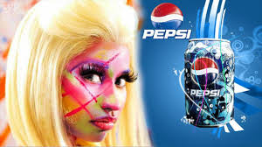
Notes:
Considering this alongside brand extension, artist brand endorsement is an important way of enhancing an artist’s narrative and image.
Notable examples including Madonna and Louis Vuitton and Dolce & Gabbana, Jay-Z and Duracell, Nicki Minaj and Pepsi, Jennifer Lopez and L’Oreal, Justin Timberlake and Givenchy, and more.
“Posh” Spice, for example, has featured regularly as a fashion icon in various celebrity magazines like Heat, Hello and OK!.
Celebrity brand ambassadors are an integral part of the brand itself.
Image credits:
Duracell Powermat And Jay Z Team Up To Empower The People. 2012. Available at http://hiphopfirstclass.com/2012/08/09/duracell-powermat-and-jay-z-team-up-to-empower-the-people/, accessed 23 March 2018.
Celebrity Endorsements can be hazardous for your health. 2016. available at https://www.eurweb.com/2016/07/study-celebrity-endorsements-can-hazardous-health/, accessed 23 March 2018.
Dolce & Gabbana Winter 2011 Madonna Ad Campaign. 2011. available at https://pursuitist.com/dolce-gabbana-winter-2011-madonna-ad-campaign/, accessed 23 March 2018.

Slide 20
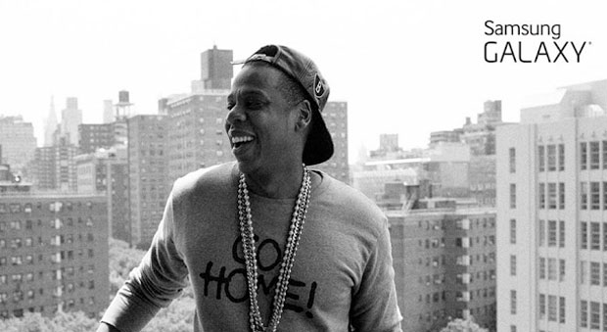
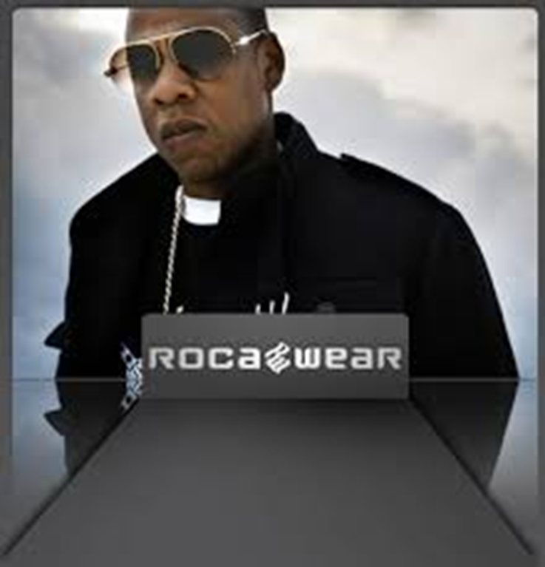
Notes:
Hip hop rapper Jay-Z provides an example of a successful cross-media brand. Having set up his own sub-business Roc-Nation (part-funded and owned by Live-Nation), which creates revenues from music sales, artist management, and touring, Jay-Z also branched into the service industry by co-founding a chain of sports bars and night clubs called the 40/40 Club, while Roca-wear clothing lines, coupled with his own line of footwear for Reebok and transnational advertising campaigns, such as his deal with Coca Cola, further strengthens his worldwide fan base. In 2013, Jay-Z partnered with Samsung for the release of his album Magna Carta Holy Grail, who bought one million albums to entice Samsung users to download an app in return for a free copy of the album.
Image credits:
Rocawear Fashion Show. Available at http://www.heels.com/fashion-show/rocawear, accessed 23 March 2018.
Jay-Z Magna Carta app hacked with anti-government messages following privacy concerns. 2013. available at http://www.thedrum.com/news/2013/07/05/jay-z-magna-carta-app-hacked-anti-government-messages-following-privacy-concerns, accessed 23 March 2018.

Slide 21
“the enterprising self”—an entrepreneur of itself—that reflects a new body politics associated with healthiness and fitness, self-improvement, autonomy, and enterprise training, and which is one of the reasons why popular culture has adopted language like “beyond the sell-by date” (McGuigan 2009:144).
Notes:
Developing brands around musicians has allowed the music industry to recoup losses encountered due to music piracy that resulted from digitization, evident in the recent emergence of 360 (“multiple rights”) deals, which grant the record companies a percentage of profits for all revenue generated by the artist, including record sales, touring, merchandising, licensing, endorsements, book publishing, and acting. This has led to even heavier branding as the focus shifts away from music and toward the artist’s image.
For female artists this meant that marketability is shaped by youth and beauty, while for male artists the focus is on a particular type of masculinity.
Relevant here is the concept of “the enterprising self”—an entrepreneur of itself—that reflects a new body politics associated with healthiness and fitness, self-improvement, autonomy, and enterprise training, and which is one of the reasons why popular culture has adopted language like “beyond the sell-by date” (McGuigan 2009:144).
So in order to stay in the spotlight, artists must evolve as the world does, and their ability (instead of lack thereof) to do so heightens branding power, as they are able to adjust styles and reflect the audience’s needs.

Slide 22
Entrepreneurship is “hip” in the contemporary music industry and enhances an artist’s overall image.
Notes:
Through personal branding, revenue is thereby inevitably tied up in the artist’s brand.
The connection between music and branding has become increasingly customary due to technological, economic, and cultural changes, and it is now often seen as good business sense (Klein, Meier, and Powers 2016:1; Hesmondhalgh and Meier 2015:107).
Entrepreneurship is “hip” in the contemporary music industry and enhances an artist’s overall image. Jay-Z is a clear example of this.
Beyoncé is another artist who has achieved enormous impact beyond the realm of pop music and entertainment. Regarded as a highly successful entrepreneur, one of Beyoncé’s latest product was a sports fashion line introduced in 2016 to enhance the ultimate Beyoncé brand (Muchitsch 2016:1).
Media appearances, social or otherwise, are vital to the success of a branded artist, hence the vast amount of money spent on producing pop videos.
Image credit:
Beyonce launches new fashion line Ivy Park: everything you need to know . 2016. Available at http://www.mobo.com/news-blogs/beyonce-launches-new-fashion-line-ivy-park-everything-you-need-know, accessed 23 March 2018.

Slide 23
Conclusions
Constructs of masculinity and femininity are based around what is deemed to be cool in order to appeal to the consumers of today’s cool popular culture.
Notes:
Branding has become indispensable in today’s neoliberal culture.
Music branding, in particular, illustrates the increasing blurring of the distinction between branding and entertainment. It marks the branded-content movement in neoliberal culture, in which “hit brands” are the ultimate goal (Jackson, Jankovich and Sheinkop 2013).
Being a successful artist has little to do with quality records, but rather with media manipulation and image creation as a point for audience identification.
Music branding is therefore about leveraging and emphasizing different aspects of an artist’s appeal, which is most often defined by gender. The gender roles represented in the music industry have become increasingly narrow. Constructs of masculinity and femininity are based around what is deemed to be cool in order to appeal to the consumers of today’s cool popular culture.

Slide 24
Notes:
Optional audio-visual study: Merchants of Cool (2001), available at http://www.pbs.org/wgbh/pages/frontline/shows/cool/view/

